Slide 1
Comparison features between: Enteric-Coated Mycophenolate Sodium (EC-MPS) and Mycophenolate Mofetil (MMF)
NVS/SLID/042018/0137

Slide 2
OVERVIEW
Mycophenolate acid (MPA) role in Immunosuppression
Compounds comparison
Efficacy Comparison
Safety Comparison
Clinical and Economic Impact of GI Adverse Events
Conclusion

Slide 3
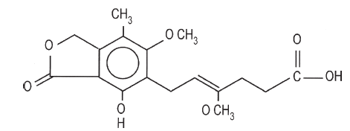
Mycophenolate Acid (MPA) Role in Immunosuppression
MPA Structure
MPA is is a nonnucleoside, noncompetitive, reversible inhibitor of inosine 5-monophosphate dehydrogenase (IMPDH)^{1,2}
IMDH is a rate-limiting enzyme in the de novo pathway of purine synthesis³
T and B lymphocytes are critically dependent on de novo synthesis of purines for their proliferation^{2,4}
Thus, MPA produces selective suppression for lymphocytes than on other cell types^{2,4}
MPA blocks the proliferation of T and B cells, inhibits alloantibody formation, and the generation of cytotoxic T cells.³
1. Transplantation Proceedings.2007. 39:88–93. 2 Transplantation 2011;91: 470–478) 3.G.Homas et al. 2011. Kidney and Pancreas Transplantation. Chapter 3: 63-65. 3. 4. Arns W et al. Clin Transplant 2005;19:199–206

Slide 4
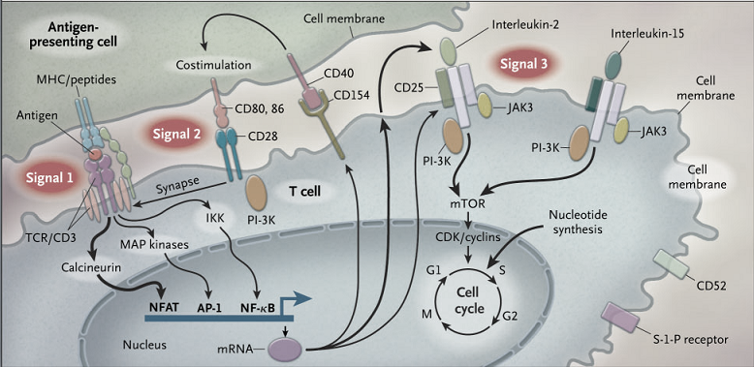
T-Cell Activation through Three Signals
MPA Acts as Anti -proliferative
Adapted from Halloran PF, et al. N Engl J Med. 2004;351:2715–2729.

Slide 5
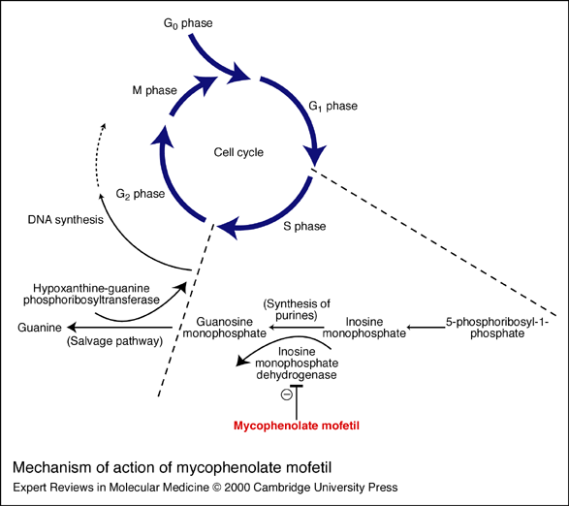
MPA Mechanism of Action
MPA
Adapted from Stepkowski, Expert Rev Mol Med, 2000;2(4):1
Notes:
The salvage pathway of purine synthesis in lymphocytes is less active than the de novo synthesis of purines. Inosine monophosphate is converted to guanosine monophosphate by inosine monophosphate dehydrogenase. During T-cell activation, the activity of
both types I and II inosine monophosphate dehydrogenase enzymes increases by ten fold. mycophenolic acid, which in turn non-competitively and reversibly inhibits types I and II inosine monophosphate dehydrogenase activity during DNA synthesis in the S phase of the cell cycle. In the salvage pathway, guanine is converted to guanine monophosphate by the enzyme hypoxanthine-guanine phosphoribosyltransferase

Slide 6
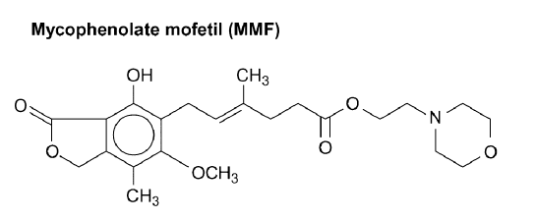
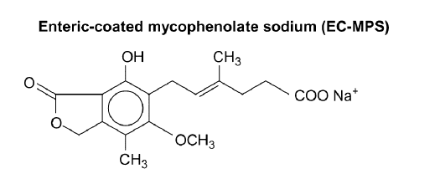
MPA Formulations: Mycophenolate Mofetil (MMF) and Mycophenolate Sodium (MPS)
There are two formulations of MPA that available: MMF and Enteric-coated MPS¹
Characteristic | MMF | EC-MPS
MPA forms | Prodrug¹ (morpholino ester of MPA) | Active drug¹
Formulation | Immediate-release¹ | Delayed release¹
Absorption | Stomach² | Small intestine²
Median T_{max} (h) ³ | 0.75 | 2
Mean AUC µg.h/mL³ | 63.7 (1000 mg) | 66.5 (720 mg)
MPA: Mycophenolate Acid. AUC: Area Under Curve. Picture adapted from Sollinger. 2004.Clin Transplant 2004. 18. 485–492 . 1. Transplantation Proceedings.2007. 39:88–93. 2. American Journal of Transplantation 2007.7. 888–898 . 3 Arns W et al. Clin Transplant 2005;19:199–206. Pictures adapted from Sollinger. 2004.Clin Transplant 2004. 18. 485–492

Slide 7
Pharmacokinetics of EC-MPS Compared with MMF
EC MPS 720 mg and MMF 1000 mg resulted in similar MPA exposure (AUC_{0-∞})^{1,2}
However, a delayed MPA maximal plasma concentration (t_{max}) was observed with EC-MPS, consistent with the enteric coated design.^{1,2}
Randomised, Crossover, Single-dose Study In 24 Stable Renal Transplant Patients²
 | n | EC-MPS 720 mg | MMF 1000 mg | p value | 90% CI
Median t_{max}, hours | 24 | 2.0 | 0.75 | <0.01 | –
Mean AUC_{0-∞}, µg.h/mL | 24 | 66.5 | 63.7 | ns | 91-109
MPA, mycophenolic acid; AUC, area under the concentration-time curve; MMF, mycophenolate mofetil; t_{max}, time to maximum concentration; CI, confidence interval; ns, not significant
1. American Journal of Transplantation 2007.7. 888–898.2. Arns W et al. Clin Transplant 2005;19:199–206

Slide 8
Efficacy Comparison
De novo renal transplants
Maintenance transplant patients
Diabetic Kidney transplant patients

Slide 9
B301 Study^{1,2}
EC-MPS vs MMF in de novo renal transplant patients
Multicentre, randomised, double-blind, 12-month, parallel-group trial¹ with 2-year open-label extension²
30 centres in Europe, USA and Canada
Adult recipients of a first renal transplant (deceased, living-unrelated or HLA-mismatched living-related donor)
Randomised to
EC-MPS 1440 mg/day (n=213)
MMF 2000 mg/day (n=210)
Cyclosporine C0 monitoring (Days 1–7, 200–400 ng/mL; Weeks 1–4, 200–300 ng/mL; Months 2–6, 150–250 ng/mL; Months 7–12, 100–200 ng/mL)
Steroids (local practice, ≥5 mg/day for ≥6 months)
HLA, human leucocyte antigen; MMF, mycophenolate mofetil
1. Salvadori M et al. Am J Transplant 2003;4:231–6;
2. Salvadori M et al. Clin Nephrol 2006;66:112–9
Notes:
REFORMATTED ONLY

Slide 10
STUDY DESIGN: B301²
Screening
EC MPS long term (n=122)
EC MPS 1440 mg/day (n=213)
Renal
transplant
+ CsA
+ corticosteroids
MMF 2000 mg/day (n=210)
EC MPS newly exposed (n=125)
Time (months)
0
12
24
36
Double blind¹
Open-label extension²
MMF, mycophenolate mofetil; CsA= Cyclosporin A; EC MPS: Enteric coated Mycophenolate sodium (EC MPS)
1. Salvadori M et al. Am J Transplant 2003;4:231–6;
2. Picture adapted from Salvadori M et al. Clin Nephrol 2006;66:112–9
Notes:
Multicentre, randomised, double-blind, 12-month, parallel-group trial with 2-year open-label extension 30 centres in Europe, USA and Canada
Adult recipients of a first renal transplant (deceased, living-unrelated or HLA-mismatched living-related donor)
Randomised to EC MPS 1440 mg/day (n=213),
MMF 2000 mg/day (n=210),
Neoral® C0 monitoring (Days 1–7, 200–400 ng/mL; Weeks 1–4, 200–300 ng/mL; Months 2–6, 150–200 ng/mL; Months 7–12, 100–200 ng/mL)
Steroids (local practice, ≥5 mg/day for ≥6 months)

Slide 11
Result : EC MPS and MMF, therapeutically equivalent in de novo KTx patients
MULTICENTRE, RANDOMISED, DOUBLE-BLIND TRIAL IN DE NOVO KIDNEY TRANSPLANT PATIENTS (B301)
BPAR, graft loss or death
28.1
p=ns
26.3
BPAR
24.3
p=ns
22.5
Biopsy-proven chronic rejection (3–12 months)
6.2
p=ns
2.8
6.7
p=ns
MMF (n=210)
Graft loss or death
EC MPS (n=213)
5.2
0
5
10
15
20
25
30
35
Incidence of events at 1 year (%)
EC MPS ; Enteric coated Mycophenolate sodium
MMF, mycophenolate mofetil; BPAR, biopsy-proven acute rejection; ns, not significant. Ktx = Kidney transplantation
Adapted from Salvadori M et al. Am J Transplant 2003;4:231–6
Notes:
REFORMATTED ONLY

Slide 12
EC-MPS: sustained long-term efficacy in cross-study comparisons
CROSS-STUDY COMPARISON OF LONG-TERM EFFICACY OF EC-MPS AND MMF (12–36 MONTHS POST-TRANSPLANT)
8
MMF (Study B201, n=141)
Newly exposed EC MPS (Study B301, n=125)
MMF (Study B251, n=150)
Long-term EC-MPS (Study B301, n=122)
6
5.7
4.7
4.8
4.9
Incidence during Months 12–36 post-transplant (% patients)
4
3.3
2.8
2.1
2.4
2.0
2
1.6
0.7
0.8
0
BPAR
Graft loss
Death or graft loss
EC-MPS: Enteric coated Mycophenolate sodium , MMF, mycophenolate mofetil; BPAR, biopsy-proven acute rejection; ns, not significant
Salvadori M et al. Clin Nephrol 2006;66:112–9
Notes:
REFORMATTED ONLY

Slide 13
Myfortic® vs MMF in maintenance transplant patients
B302 Study
Multicentre, RCT, double-blind, double-dummy, 12-month, parallel-group trial¹ with 2-year open-label extension.^{2.}Myfortic® vs MMF in maintenance transplant patients
34 centres in Europe, USA and Canada
Adult recipients of first or second renal transplant (deceased or living donor)
>6 months post-transplant, receiving MMF 2 g/day, CsA ± steroids for >4 weeks prior to screening
Stable graft function (serum creatinine <204 μmol/L at screening or study baseline, and increase in serum creatinine <20% between screening and study baseline)
After 14-day run-in period, randomised to
EC-MPS1440 mg/day (n=159)
MMF 2000 mg/day (n=163)
CsA target C0 level: 100–200 ng/mL
EC-MPS: Enteric coated Mycophenolate sodium, MMF, mycophenolate mofetil; CsA, cyclosporin
1. Budde K et al. Am J Transplant 2003;4:237–43; 2. Budde K et al. Clin Nephrol 2006;66:103–11
Notes:
REFORMATTED ONLY

Slide 14
Study design: B302
>6 months post-transplant
Screening
EC-MPS 1440 mg/day (n=159)
EC-MPS long term n=130 n=98
MMF 2 g/day
+ CsA
± corticosteroids
+ CsA
± corticosteroids
MMF 2000 mg/day (n=163)
EC-MPS newly exposed n=130 n=97
Time (months)
0
12
24
36
Double blind¹
Open-label extension²
EC-MPS: Enteric coated Mycophenolate sodium, MMF, mycophenolate mofetil; CsA, cyclosporin
Adapted from 1. Budde K et al. Am J Transplant 2003;4:237–43;
2. Budde K et al. Clin Nephrol 2006;66:103–11
Notes:
REFORMATTED ONLY

Slide 15
Result : There were no statistically significant differences between EC-MPS and MMF in the efficacy parameters measured
MULTICENTRE, RANDOMISED, DOUBLE-BLIND STUDY TRIAL IN MAINTENANCE KIDNEY TRANSPLANT PATIENTS (B302)
Biopsy-proven chronic rejection
4.9
p=ns
3.8
3.1
p=ns
Graft loss or death
1.3
MMF (n=163)
3.1
EC-MPS(n=159)
BPAR
1.3
p=ns
0
2
4
6
8
10
Incidence of events at 1 year (%)
EC-MPS: Enteric coated Mycophenolate sodium , MMF, mycophenolate mofetil; BPAR, biopsy-proven acute rejection; ns, not significant
Budde K et al. Am J Transplant 2003;4:237–43
Notes:
REFORMATTED ONLY

Slide 16
EC-MPS vs MMF in diabetic kidney transplant patients
Post Hoc Analysis
Background: The pharmacodynamics and pharmacokinetics of drugs may be altered in patients with diabetes
Objective: To examine the efficacy and safety of EC-MPS in renal transplant patients with diabetes mellitus (DM).
Post hoc Analysis from three clinical trials with EC-MPS:
B301 (de novo kidney transplant (KTx) patients)
B302 (maintenance KTx patients)
myPROMS (open label, de novo & maintenance KTx patients)
Total sample patients with DM, N= 246
Pietruck F et al. Clin Transplant 2007;21:117–25

Slide 17
Result: Post hoc analysis suggests that EC-MPS is as efficacious as MMF in diabetic kidney transplant patients
POST HOC ANALYSIS OF DATA FROM DIABETIC DE NOVO KIDNEY TRANSPLANT PATIENTS PARTICIPATING IN A MULTICENTRE, DOUBLE-BLIND, RANDOMISED STUDY OF EC-MPS OR MMF WITH CsA AND STEROIDS (B301)
MMF (n=42)
19.0
p=ns
EC-MPS (n=34)
BPAR
14.7
Graft loss or death
7.1
2.9
Graft loss
2.4
2.9
0
10
20
30
40
Incidence at 12 months (%)
EC-MPS: Enteric Coated Mycophenolate Sodium. MMF, mycophenolate mofetil; CsA= Cyclosphorine, BPAR, biopsy-proven acute rejection; ns, not significant
Adapted from Pietruck F et al. Clin Transplant 2007;21:117–25
Notes:
REFORMATTED ONLY

Slide 18
Safety Comparison
molecular comparison
Study in kidney transplant patients
Study in autoimmune patients

Slide 19
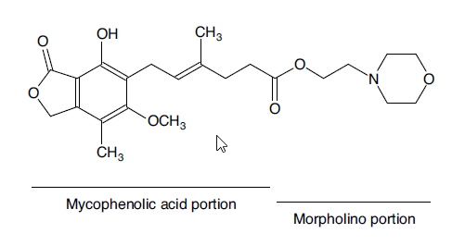
Distinct features of MMF vs EC-MPS led to different GI effects
Mycophenolate Mofetil¹
Mycophenolate sodium ²
Sodium
Mycophenolic acid portion
MMF is rapidly deesterified to produce MPA and mofetil (N-[2-hydroxyethyl] morpholine) in stomach. ^{1,2}
N-(2-hydroxyethyl)morpholine has local irritative effects and may cause gastrointestinal irritation with nausea, vomiting and diarrhea.^{2,3}
The active moiety in EC-MPS : MPA.²
EC MPS is developed to improve MPA-related upper GI adverse events⁴
The enteric coating of EC-MPS dissolves at pH > 5.5 to 6.0, allowing for delay of MPA delivery until it reaches the small intestine.⁴
MPA: Mycophenolate acid, MMF: Mycophenolate Mofetil. GI: Gastro intestinal 1. Clin Pharmacokinet 1998 Jun; 34 (6).2.Transplantation Proceedings, 39, 88–93 (2007).3. N-(2-hydroxyethyl)morpholine. Material Safety Data Sheet. Available at: pim-resources.coleparmer.com. Accessed 02 March, 2018. 4. Arn w.et al. Clin Transplant 2005. 19.199–206

Slide 20
Quantifying the incidence of MPA-related GI adverse effects is challenging due to:
High prevalence of GI complaints even in the absence of MPA therapy, due to the use of other immunosuppressive agents and surgery stress
Data collection techniques for GI events vary considerably between clinical trials
Quantifying the severity of specific GI events is notoriously difficult
Thus, data from the maintenance renal transplant patient pool may be more informative, since after long-term MPA therapy patients have generally achieved an acceptable level of tolerance or discontinued therapy
MPA: Mycophenolate acid, MMF: Mycophenolate Mofetil. GI: Gastro intestinal Transplantation Proceedings, 39, 88–93 (2007)

Slide 21
Clinical Study to Assess Safety in Renal Transplant
EC MPS vs MMF

Slide 22
PROGIS STUDY
PROGIS –
Patient-Reported Outcomes in renal transplant patients with or without GastroIntestinal Symptoms
Study objectives
Identify and evaluate the impact of GI symptoms on patients’ perceptions of symptom severity and HRQoL
Determine if GI symptom severity and HRQoL improve after patients are converted from MMF to EC-MPS
Study assessments
GSRS, GIQLI and OTE
Study design
Open-label, longitudinal, non-randomised, prospective, multicentre study
2 independent cohorts of maintenance renal transplant patients (Cohort B validating results of Cohort A)
Cohort A: patients on MMF suffering from GI complications converted to equimolar doses of EC-MPS at baseline
Cohort B: patients without GI complications remained on MMF
GI, gastrointestinal; HRQoL; health-related quality of life; MMF, mycophenolate mofetil; GSRS, Gastrointestinal Symptom Rating Scale; GIQLI, Gastrointestinal Quality of Life Index: OTE, Overall Treatment Effect . MMF; Mycophenolate mofetil, EC-MPS: Mycophenolate sodium
Chan L et al. Transplantation 2006;81:1290–7
Notes:
REFORMATTED ONLY

Slide 23
Study population: PROGIS
Key inclusion criteria
>18 years of age; kidney transplantation >1 month prior; taking MMF >2 weeks; the 2 groups of patients were those eligible to convert to EC-MPS if experiencing MMF-related GI events AND those who were not experiencing GI problems and continuing on MMF
Key exclusion criteria
GI symptoms not caused by MPA; acute rejection episode <1 week prior; or were undergoing acute medical intervention or hospitalization
MMF, mycophenolate mofetil; GI, gastrointestinal; MPA, mycophenolic acid, EC MPS: Mycophenolate sodium
Chan L et al. Transplantation 2006;81:1290–7
Notes:
REFORMATTED ONLY

Slide 24
Study population: PROGIS
7 centres
n=328 enrolled (safety population = ITT)
Protocol violations and / or premature discontinuation: n=50
n=278 analysed (per-protocol population)
Cohort A: n=177
Cohort B: n=101
ITT, intent to treat
Chan L et al. Transplantation 2006;81:1290–7
Notes:
REFORMATTED ONLY

Slide 25
Study design: PROGIS
MMF, GI problems (Cohort A)
Patients converted to
EC-MPS
Physician assessment
4–6 weeks
Baseline, Visit 1
Visit 2
MMF, no GI problems (Cohort B)
Patients continued
on MMF
Patient-Reported Outcomes questionnaire
Patient-Reported Outcomes questionnaire
MMF, mycophenolate mofetil; GI, gastrointestinal, EC-MPS: Mycophenolate sodium
Adapted from Chan L et al. Transplantation 2006;81:1290–7
Notes:
REFORMATTED ONLY

Slide 26
Validated instruments were used to assess patient-reported outcomes in PROGIS
1. Gastrointestinal Symptom Rating Scale (GSRS)
Questionnaire designed to assess the symptoms associated with common GI disorders. It has five subscales (reflux, diarrhea, constipation, abdominal pain and indigestion)
2. Gastrointestinal Quality of Life Index (GIQLI)
Questionnaire designed designed to assess HRQoL in clinical practice and in clinical trials of patients with GI disorders. It has five subscales (GI symptoms, emotional status, physical function, social function and use of medical treatment)
3. Overall Treatment Effect (OTE)
Overall assessment of changes in GI symptoms and HRQoL (Visit 2 only)
GI, gastrointestinal; HRQoL, health-related quality of life
Chan L et al. Transplantation 2006;81:1290–7
Notes:
REFORMATTED ONLY

Slide 27
Upper and lower GI symptom burden improves after conversion from MMF to Myfortic®
GSRS SUBSCALE SCORES AT BASELINE (MMF)
No
discomfort
Abdominal pain
Reflux syndrome
Diarrhoea
Indigestion syndrome
Constipation
1
2
1.9
1.6
1.7
2.1
2.2
2.3
3
2.8
2.6
Mean GSRS subscale scores
3.2
3.3
4
p<0.0001 for all subscales vs baseline
5
Very
severe
discomfort
6
Baseline (MMF)
7
Visit 2 (Myfortic®)
A difference ranging from 0.4–0.8 is indicative of clinical relevance*
n=176
*As defined by the minimal important difference. GI, gastrointestinal; MMF, mycophenolate mofetil;
GSRS, Gastrointestinal Symptom Rating Scale. EC MPS: Mycophenolate sodium
Adapted from Chan L et al. Transplantation 2006;81:1290–7
Notes:
REFORMATTED ONLY

Slide 28
All GIQLI subscale scores improved after conversion from MMF to EC MPS
MEAN GIQLI SUBSCALE SCORES
p<0.0001 for all subscales vs baseline
Better HRQoL
4
3.4
Baseline (MMF)
3.3
3
2.9
3.0
3.0
Visit 2
(EC MPS)
2.7
2.6
2.7
2.3
Mean GIQLI subscale scores
2
1.8
1
Worse HRQoL
0
Symptoms
Emotion
Physical function
Social function
Medical treatment
A difference ranging from 0.2–0.5 is indicative of clinical relevance*
n=177
*As defined by the minimal important difference GIQLI, Gastrointestinal Quality of Life Index; MMF, mycophenolate mofetil; HRQoL, health-related quality of life
Adapted from Chan L et al. Transplantation 2006;81:1290–7
Notes:
REFORMATTED ONLY

Slide 29
Patient- and physician-perceived GI symptoms improved after conversion from MMF to EC MPS
PATIENT RATED
PHYSICIAN RATED
Improvement Worse
Unchanged Missing
OTE
n=177
GI, gastrointestinal; MMF, mycophenolate mofetil; OTE, Overall Treatment Effect
Adapted from Chan L et al. Transplantation 2006;81:1290–7
Notes:
29
REFORMATTED ONLY

Slide 30
Clinical Study to Assess Safety in Autoimmune Diseases
EC MPS vs MMF

Slide 31
Impact of switching from MMF to EC-MPS on GI side effects in patients with autoimmune disease: a Phase III, open-label, single-arm, multicenter study
Study Objectives
Assess changes in GI severity in patients with autoimmune disease who were switched from MMF to EC-MPS
Study Assessments
GSRS, GIQLI and OTE
Primary endpoints: Change in the Gastrointestinal Symptom Rating Scale (GSRS) total score after 6–8 weeks of treatment (Visit 2).
Study Design
Multicenter, 19 centers, single arm, phase III, N= 111.
GI, gastrointestinal; MMF, mycophenolate mofetil;
EC MPS: Mycophenolate sodium
Clinical and Experimental Gastroenterology 2015:8 205–213

Slide 32
Inclusion
Patients aged ≥ 18 years with an autoimmune disease and who received immunosuppressive therapy including MMF at time of enrolment
Required MPA treatment for the study duration, and were willing to switch to EC-MPS
MMF and any concomitant drugs that might cause GI symptoms had to be administered at stable doses for at least 1 month before enrolment and during the study
Females of child-bearing age had to present a negative pregnancy test at baseline
Exclusion
Hypersensitivity to the formulations of MPA and other drug components
GI symptoms not caused by MPA therapy
acute medical intervention or hospitalization or conditions not related to GI events which required immediate medical intervention.
Clinical and Experimental Gastroenterology 2015:8 205–213

Slide 33
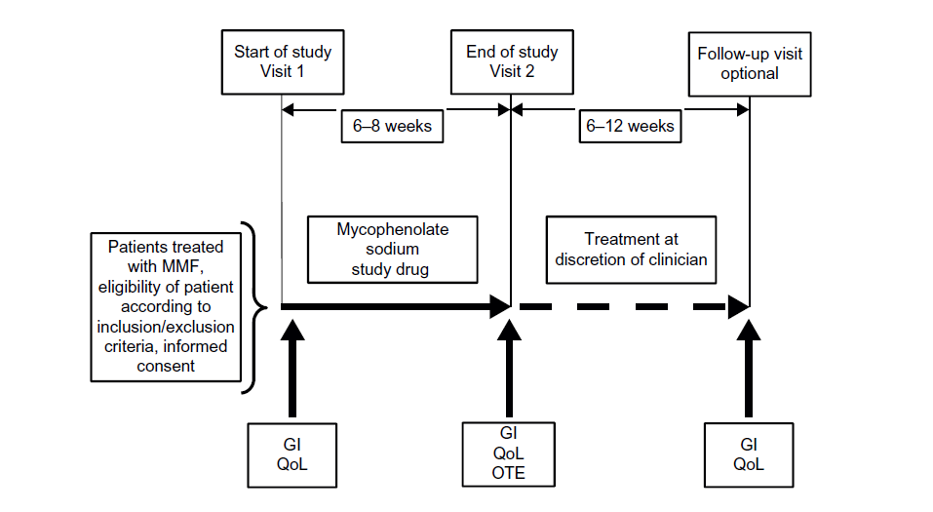
Study Design
Start of study Visit 1
End of study Visit 2
Follow-up visit optional
EC-MPS is given
GI
QoL
GI
QoL
OTE
GI
QoL
GI, gastrointestinal; MMF, mycophenolate mofetil; EC-MPS: Enteric coated mycophenolate sodium; OTE, Overall Treatment Effect; QoL: Quality of Life;
Adapted from Clinical and Experimental Gastroenterology 2015:8 205–213

Slide 34
Result: A Statically significant improvement in GSRS total score after conversion from MMF to EC-MPS
GSRS SUBSCALE SCORES AT BASELINE vs AFTER 2nd VISIT
No
discomfort
Total score
Reflux
Diarrhea
Constipation
Abdominal
pain
Indigestion
P=0.002
P= < 0.001
Very
severe
discomfort
P=0.002
N= 111
Minimal clinically important difference (0.33)
Adapted from Clinical and Experimental Gastroenterology 2015:8 205–213

Slide 35
Clinical and Economic Impact of GI Adverse Events
Renal transplant
Autoimmune

Slide 36
Clinical Impact & Economic Impact of GI Adverse Events In Renal Transplantation
GI complications associated with MPA therapy negatively affect patients’ quality of life and increase the risk of noncompliance¹
Studies shown that reduction of MPA dose, or discontinuation of MPA therapy, has a significant adverse effect on graft outcome. ¹
Health care costs are also higher in patients who experience MPA-related GI effects, particularly if they discontinue MMF¹
In autoimmune diseases, GI manifestations are common and lead to significant impairment of patients’ quality of life. ²
GI, gastrointestinal; MPA: Mycophenolate Acid: MMF, mycophenolate mofetil;
1. Transplantation Proceedings, 39, 88–93 (2007). 2 Clinical and Experimental Gastroenterology 2015:8 205–213

Slide 37
CONCLUSION
Different features between MMF and EC-MPS in term of MPA form and dosage form led to different upper GI effect
Efficacy MMF and EC-MPS are equivalent in de novo, maintenance, and diabetic renal transplant
GI adverse events using immunosuppressant lead to non compliance, impairment of patient quality of life and higher cost.

