Slide 1

Introducing
The New Formulation of Deferasirox
that Patients Prefer
NVS/SLID/102019/328
Notes:
Hello and welcome. Today, I’d like to talk with you about the new and improved formulation of deferasirox and present the results from ECLIPSE, the primary analysis assessing the safety of EXJADE film-coated tablets (FCT).
EXJADE FCT is a once-daily oral tablet for iron chelation indicated for:
The treatment of chronic iron overload due to blood transfusions (transfusional hemosiderosis) in adult and pediatric patients (aged 2 years and over)
The treatment of chronic iron overload in patients with non-transfusion–dependent thalassemia syndromes aged 10 years and older

Slide 2







Same active ingredient, new once-daily formulation¹
EXJADE dispersible tablets (DT)
EXJADE film-coated tablets (FCT)
Once-daily oral suspension
Once-daily film-coated tablets
Multistep preparation may conflict with daily activities
No preparation or mixing required
For patients who are unable to swallow a whole tablet, it may be crushed and
sprinkled on soft food
Restrictions on taking with food
May be taken with or without a
light meal
Palatability issues can make administration a challenge
Does not contain lactose and
sodium lauryl sulfate
References: 1. Exjade Dispersible Tablet / Film Coated Tablet Product Information
Notes:
EXJADE FCT has the same active ingredient (deferasirox) as EXJADE dispersible tablets (DT), and the dose administered has been reduced in order to achieve a similar overall exposure (area under the curve, or AUC).
EXJADE FCT minimizes the mixing process required to administer EXJADE DT and reduces food effect:
It can be taken with or without a light meal
It can be swallowed whole with water or crushed and sprinkled on food
EXJADE FCT offers increased palatability. It does not have a taste or an aftertaste, eliminating the chalky, bad-tasting liquid that patients found displeasing with the DT formulation.
In addition, the new formulation:
Is sodium lauryl sulfate–free
Is lactose-free
Has a more predictable dose exposure due to standardized drug intake
The results from the ECLIPSE trial demonstrate the new formulation offers similar overall safety and pharmacokinetics (PK) as the DT formulation. We’ll get to those details in a minute, but let’s first take a closer look at the 2 formulations and the ECLIPSE study.

Slide 3

Deferasirox for transfusional iron overload
EXJADE DT
EXJADE FCT
Available dosage strengths
250, 500 mg
180, 360 mg
Recommended starting doses
(mg/kg/day)
PRBC transfusions (units/month)
<2
2-4
>4
10
20
30
7
14
21
Titrating increments (mg/kg/day)
As needed every 3-6 months, based on serum ferritin trends
5-10
3.5-7
Maximum dose (mg/kg/day)
40
28
Dose reductions in steps of 5 to 10 mg/kg (EXJADE DT) or 3.5 to 7 mg/kg (EXJADE FCT) should be considered when serum ferritin levels fall below 1000 µg/L. Treatment should be interrupted if serum ferritin levels consistently fall below 500 µg/L.
PRBC, packed red blood cells.
Reference: Exjade Dispersible Tablet / Film Coated Tablet Product Information
Notes:
Both EXJADE FCT and DT are indicated for:
The treatment of chronic iron overload due to blood transfusions (transfusional hemosiderosis) in adult and pediatric patients (aged 2 years and over).
The treatment of chronic iron overload in patients with non-transfusion–dependent thalassemia syndromes aged 10 years and older.
The dosing information shown here is for transfusional iron overload.
EXJADE FCT is available in 90-, 180-, and 360-mg dosage strengths, compared with 125-, 250-, and 500-mg for EXJADE DT.
Recommended EXJADE FCT starting doses are 30% less than EXJADE DT starting doses.

Slide 4
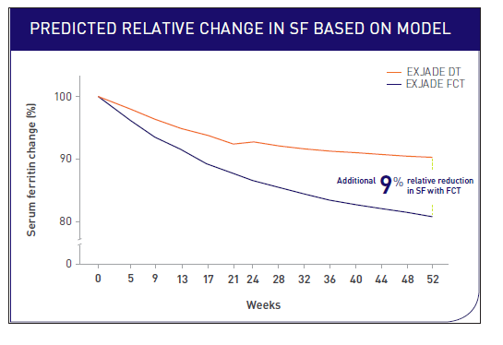
FCT Formulation can Enhance Serum Ferritin Reduction vs DT
Reference: Taher AT, Weber S, Han J, Bruederle A, Porter j. Predicting serum ferritin levels in patients with iron overload treated with the lm-coated tablet of deferasirox during the ECLIPSE study. Am J Hematol.. 2019 Jan; 94(1): E15-E17.

Slide 5
ECLIPSE study objectives
Overall Objective
  Evaluate overall safety of EXJADE FCT and EXJADE DT
Primary end points
Frequency and severity of AEs
Changes in laboratory values (baseline to 24 weeks)
Key secondary end points
  Select gastrointestinal (GI)-related AEs
  Patient-reported outcomes (PRO)
  Satisfaction
  Palatability
  GI symptoms
  Treatment compliance
Reference: Taher AT, Origa R, Perrotta S, et al. New film-coated tablet formulation of deferasirox is well tolerated in patients with thalassemia or lower-risk MDS: results of the randomized, phase II ECLIPSE study. Am J Hematol. 2017;92(5):420-428.
Notes:
The overall objective of ECLIPSE was:
To evaluate the overall safety of EXJADE FCT vs EXJADE DT formulations
The primary end points of ECLIPSE measured:
Percentage of patients with at least 1 adverse event (AE)
Changes in laboratory values (baseline to 24 weeks)
The key secondary end points of ECLIPSE evaluated both formulations on:
Select gastrointestinal (GI) AEs (diarrhea, nausea, abdominal pain, increased urine protein/creatinine ratio [UPCR; >0.5 mg/mg], and vomiting)
PK of both formulations
Patient satisfaction, palatability, and GI symptoms using patient-reported outcomes (PRO) tools and daily diary
The study was conducted in patients with transfusion-dependent thalassemia or very low-, low-, or intermediate-risk myelodysplastic syndromes (MDS).

Slide 6
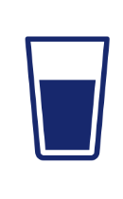
ECLIPSE study design (N=173)
Screening
(including washout)
14 days
EXJADE DT
(n=86)
Randomization (1:1)
Follow-up
Key inclusion criteria
Serum ferritin >1000 ng/mL
Key exclusion criteria
CrCl <60 mL/min or
<40 mL/min (per local label)
SCr >1.5 × ULN
ALT >5 × ULN (unless liver iron concentration confirmed as >10 mg Fe/g dry weight ≤6 months prior to screening)
UPCR >0.5 mg/mg
Impaired GI function
1 month
EXJADE FCT
(n=87)
Follow-up
1 month
24 weeks
24 weeks
ALT, alanine aminotransferase; CrCl, creatinine clearance; SCr, serum creatinine; ULN, upper limit of normal; UPCR, urine protein/creatinine ratio.
Reference: Taher AT, Origa R, Perrotta S, et al. New film-coated tablet formulation of deferasirox is well tolerated in patients with thalassemia or lower-risk MDS: results of the randomized, phase II ECLIPSE study. Am J Hematol. 2017;92(5):420-428.
Notes:
ECLIPSE was a 24-week randomized, open-label, multicenter, two-arm, Phase II study to investigate the benefits of an improved deferasirox FCT formulation vs the DT formulation.
Written informed consent was required for participation in this study. Study participants had to meet the following inclusion criteria:
At least 10 years old
Have transfusion-dependent thalassemia and chronic iron overload, requiring deferasirox DT at doses of ≥30 mg/kg/day as per the investigator's decision OR with very low-, low-, or intermediate-risk MDS and chronic iron overload, requiring deferasirox DT at doses of ≥20 mg/kg/day as per the investigator's decision
Have a history of transfusion of at least 20 units of packed red blood cells (PRBC) and anticipated to be transfused with at least 8 units of PRBC annually during the study
Serum ferritin >1000 ng/mL, measured at screening Visit 1 and screening Visit 2 (the mean value will be used for eligibility criteria)
Key exclusion criteria were: creatinine clearance (CrCl) below contraindication limit as per local label (<60 mL/min or <40 mL/min); serum creatinine (SCr) >1.5 × upper limit of normal (ULN); alanine aminotransferase (ALT) >5×ULN (unless liver iron concentration confirmed as >10 mg Fe/g dry weight ≤6 months prior to screening); UPCR >0.5 mg/mg; or impaired GI function.
There was a screening period of 14 days to assess eligibility of patients. If eligible, any current chelation therapy was discontinued and patients underwent a 5-day washout period. Patients were then randomized to either DT or FCT treatment arm in 1:1 ratio for 24 weeks:
86 patients received EXJADE DT as per local label
87 patients received EXJADE FCT taken with or without a light meal
Patients were stratified by prior EXJADE treatment and type of anemia (MDS or thalassemia).
Patients were followed for 30 days after last dose of study drug for safety.

Slide 7
ECLIPSE patient demographics
Patients with chronic iron overload
50.9% female, 49.1% male
Age range: 11 to 81 years
  Median age: 28 years
80.9%
18.5%
90.2%
of patients had transfusion-dependent thalassemia
(n=140)
of patients had myelodysplastic
syndromes (n=32)
Very low risk: 3.5%
Low risk: 10.4%
Intermediate risk: 4.6%
of patients were previously treated with
an iron chelator;
80.3%
of those patients were
on EXJADE DT
Reference: Taher AT, Origa R, Perrotta S, et al. New film-coated tablet formulation of deferasirox is well tolerated in patients with thalassemia or lower-risk MDS: results of the randomized, phase II ECLIPSE study. Am J Hematol. 2017;92(5):420-428.
Notes:
Let’s discuss the patient demographics and disease characteristics next. Overall, the patient demographics were similar across both treatment groups.
The median age was 28 years
49.1% were male
50.9% were female
Note that slightly more male patients were treated with EXJADE FCT, but the difference was small (52.9% vs 45.3%)
As far as disease characteristics:
80.9% of patients had transfusion-dependent thalassemia (n=140, 70 patients in each arm)
18.5% of patients in each treatment arm had MDS (16 patients in each arm)
6 patients had very low-risk MDS, 18 had low-risk MDS, and 8 had intermediate-risk MDS
There was a larger proportion of patients with intermediate-risk MDS as per the revised International Prognostic Scoring System (IPSS-R) in the EXJADE DT–treated arm (8.1%) than the EXJADE FCT–treated arm (1.1%), but as the total number of patients with MDS was very small overall, this could not have influenced the study results
Note patient disease characteristics do not total 100% because 1 patient did not have a disease state identified in the study
Additionally:
90.2% of patients had been on previous chelation therapy
80.3% of those patients had taken EXJADE DT
9.8% of patients were treatment-naive
All randomized patients received treatment, and most completed the study.
89% of patients treated with EXJADE FCT completed the study vs 85% of patients treated with EXJADE DT
In total, 13.3% of patients discontinued study treatment, with 5.8% discontinuing due to AEs

Slide 8
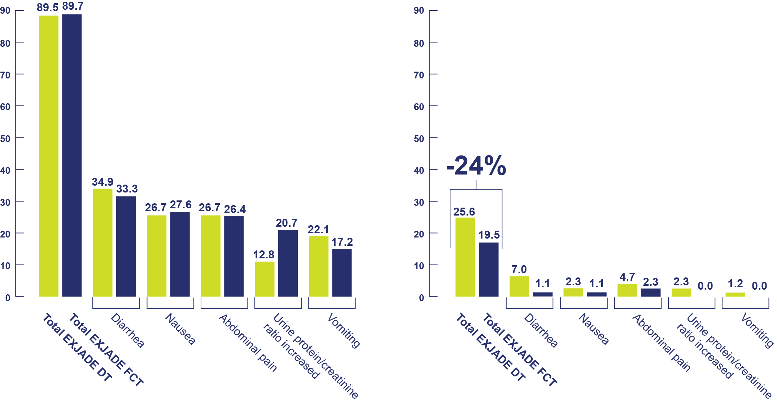
Safety for Exjade FCT is comparable with Exjade DT*^{†ǂ}
All AEs
Severe AEs
  % of patients
  % of patients
EXJADE DT
EXJADE DT
EXJADE FCT
EXJADE FCT
*As seen in greater than 10% in any group regardless of study drug relationship.
†The incidence of any AEs overall and by severity was summarized by treatment using frequency counts, percentages of patients, and 95% confidence intervals for percentages obtained using Clopper-Pearson method.
^{ǂ}P values were not recorded in this study.
Reference: Taher AT, Origa R, Perrotta S, et al. New film-coated tablet formulation of deferasirox is well tolerated in patients with thalassemia or lower-risk MDS: results of the randomized, phase II ECLIPSE study. Am J Hematol. 2017;92(5):420-428.
Notes:
This table shows the most common overall and severe AEs seen in greater than 10% in any group regardless of study drug relationship.
Recall that 80.9% of patients had transfusion-dependent thalassemia (70 patients in each arm) and 18.5% of patients in each treatment arm had MDS (16 patients in each arm).
The frequency of AEs was similar across both treatment groups, as about 90% of all patients in each group experienced at least 1 AE during the treatment period
While there were few severe AEs for both formulations, fewer severe AEs were reported with the new formulation
Diarrhea was the most common AE experienced in both treatment groups
Vomiting and constipation were more common in patients treated with EXJADE DT than in patients treated with EXJADE FCT
It’s important to call out that renal disorders and proteinuria were more common in patients receiving EXJADE FCT. This was most likely due to the fact that some patients received higher than protocol-recommended doses of EXJADE FCT and were not dose-managed according to recommendations. Patients who received the recommended dose showed no difference in the rate of proteinuria between FCT and DT. Physicians need to be careful and switch patients from DT to FCT or start patients on FCT at the doses recommended in the label.
The most common overall and severe AEs in both treatment groups in ECLIPSE were:
Diarrhea
Nausea
Abdominal pain
Increased urine protein/creatinine ratio
Vomiting
Hematuria
Proteinuria
Pyrexia
AEs with >5% difference between treatment arms included:
Urine protein/creatinine ratio increased—more frequent in patients receiving EXJADE FCT (20.7% vs 12.8%)
Hematuria—more frequent in patients receiving EXJADE FCT (9.2% vs 2.3%)
Constipation—more frequent in patients receiving EXJADE DT (15.1% vs 8%)
Headache—more frequent in patients receiving EXJADE DT (14% vs 5.7%)
Influenza—occurred only in patients receiving EXJADE DT (5.8%)
Please note that the incidence of any AEs overall and by severity was summarized by treatment using frequency counts, percentages of patients, and 95% confidence intervals for percentages obtained using the Clopper-Pearson method.

Slide 9
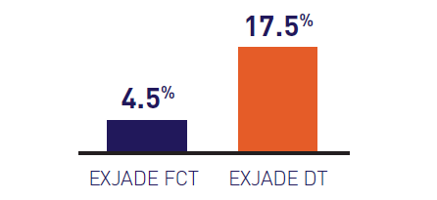
Few severe GI AEs
experienced with EXJADE FCT*
Reference: Taher AT, Origa R, Perrotta S, et al. New film-coated tablet formulation of deferasirox is well tolerated in patients with thalassemia or lower-risk MDS: results of the randomized, phase II ECLIPSE study. Am J Hematol. 2017;92(5):420-428.
Notes:
Select GI AEs, a secondary study end point, were also similar, but fewer severe GI AEs were seen with EXJADE FCT:
Select GI AEs were diarrhea, nausea, abdominal pain, increased UPCR (>0.5 mg/mg), and vomiting
58.6% of patients taking EXJADE FCT experienced at least 1 GI AE vs 61.6% of patients taking EXJADE DT
Fewer severe select GI AEs were reported in patients receiving EXJADE FCT:
4.5% of patients taking EXJADE FCT experienced severe select GI AEs vs 17.5% of patients taking EXJADE DT
Select GI AEs were diarrhea, nausea, abdominal pain, increased UPCR (>0.5 mg/mg), and vomiting
Recall that 80.9% of patients had transfusion-dependent thalassemia (70 patients in each arm) and 18.5% of patients in each treatment arm had MDS (16 patients in each arm).
PROs showed EXJADE FCT had lower GI summary scores:
Aggregated based on the side effects patients recorded in their tolerability diary (unlike AEs where every event must be reported)
Baseline is defined as Week 1 score. If missing, then Week 2 score is considered as baseline. The GI diary summary score is created by summing 5 items measured using the 10-point response scale with the response format: 0 = no pain to 10 = worst pain. Higher scores indicate worse symptoms
Additionally, based on PRO results, 70% of patients receiving EXJADE FCT reported never being upset about side effects vs 51% of patients receiving EXJADE DT.
Note that these PROs were secondary study end points assessed for both formulations using PRO questionnaires and diaries.
The first PRO was the Modified Satisfaction with Iron Chelation Therapy (SICT), which measured:
Adherence domain score (higher score indicated worse adherence)
Satisfaction/preference domain score (higher score indicated worse satisfaction)
Concern domain score (higher score indicated fewer concerns about side effects)
Adherence, satisfaction/preference, and concern domain scores were calculated by summing 6 items measured using a 5-point response scale (1 being the best, 5 being the worst). Baseline is defined as week 2 assessments. If missing, then Week 3 assessment is considered baseline.
Overall domain scores in the DT arm worsened at the end of treatment compared with baseline.

Slide 10
Patient compliance varied between treatment arms
Patients taking EXJADE FCT:
EXJADE DT
EXJADE FCT
Patient-reported outcomes
Patient-reported outcomes
Found their medication is very easy or easy to take*¹
Never thought about stopping medication*¹
92%
FCT
46%
DT
53%
FCT
38%
DT
(n=55/60)
(n=29/63)
(n=33/87)
(n=46/86)
*Based on the 70% of patients who completed the PRO questionnaire at the end of the study.
Reference: Taher AT, Origa R, et al. Patient-reported outcomes from a randomized phase II study of the deferasirox film-coated tablet in patients with transfusion-dependent anemias. Health and Quality of Life Outcomes (2018) 16:216
Notes:
More patients receiving EXJADT FCT complied with treatment, as demonstrated in the ECLIPSE trial.
Compliance was evaluated based on relative consumed pill count ([total count consumed/total count prescribed] *100).
As measured by percentage of daily doses taken:
Patients receiving EXJADE FCT consumed a mean of 92.9% of the prescribed tablet count (n=59/61)
Patients receiving EXJADE DT consumed a mean of 85.3% of the prescribed tablet count (n=73/86)
Patients taking EXJADE FCT also had a longer mean duration of exposure compared with patients taking EXJADE DT: 163 days vs 155 days.
Patients taking EXJADE FCT also were almost twice as likely to receive the highest prescribed dose.
31% of patients in the FCT treatment arm received the highest dose vs 18.6% of patients in the DT treatment arm
Additionally, PRO data, based on the 70% of patients who completed the PRO questionnaire at the end of the study, showed that 97% (n=59/61) of patients taking EXJADE FCT never thought about stopping their medication, vs 76% (46/60) of patients taking EXJADE DT.
As you can see, patients are more likely to comply with treatment with the new formulation than the DT formulation. I’d like to share other insights regarding adherence next.

Slide 11
Patients reported high satisfaction
with FCT formulation
More patients were very satisfied with
EXJADE FCT at end of treatment
EXJADE FCT
88.3%
of patients on FCT preferred FCT (n=53/60)
EXJADE DT
25.4%
of patients on DT preferred DT (n=16/63)
Reference: Taher AT, Origa R, et al. Patient-reported outcomes from a randomized phase II study of the deferasirox film-coated tablet in patients with transfusion-dependent anemias. Health and Quality of Life Outcomes (2018) 16:216
Notes:
Based on PRO results:
88.3% of patients on FCT said they preferred FCT (n=53/60), while 34.9% of patients on DT said they preferred DT (n=22/63)
Remember that patient satisfaction was a secondary study end point
Recall that 80.9% of patients had transfusion-dependent thalassemia (70 patients in each arm) and 18.5% of patients in each treatment arm had MDS (16 patients in each arm)

Slide 12

ECLIPSE shows EXJADE FCT is the formulation patients prefer
Study results
Patient-reported outcomes
Enhanced patient experience
and improved adherence²
Among patients on EXJADE FCT¹:
  4.5% reported any severe GI AE
  17.5% of EXJADE DT patients reported
  any severe GI AE
  Fewer concerns
  (ie, swallowing enough medication, limitations on daily activities, side effects)
  1% reported severe diarrhea
  7% of EXJADE DT reported severe diarrhea
  Improved adherence and palatability
  92% found FCT is very easy or easy to take ²
  Increased satisfaction
References: 1.Taher AT, Origa R, Perrotta S, et al. New film-coated tablet formulation of deferasirox is well tolerated in patients with thalassemia or lower-risk MDS: results of the randomized, phase II ECLIPSE study. Am J Hematol. 2017;92(5):420-428; 2. Taher AT, Origa R, et al. Patient-reported outcomes from a randomized phase II study of the deferasirox film-coated tablet in patients with transfusion-dependent anemias. Health and Quality of Life Outcomes (2018) 16:216
Notes:
To end our presentation, I’d like to provide a summary of all that we talked about today. New EXJADE FCT reduces food effect and improves convenience with simplified administration, while proving safe for patients with chronic iron overload.
EXJADE FCT was proven safe in ECLIPSE, a study designed to evaluate the new formulation compared to the existing formulation, EXJADE DT.
Based on the ECLIPSE study, EXJADE FCT provides:
A safety profile consistent with EXJADE DT
Similar proportions of patients in each treatment arm had GI AEs, although patients receiving EXJADE FCT experienced fewer severe AEs
A comparable PK profile to that of EXJADE DT
Lower PK variability in the new formulation
Better compliance rates
Specifically, compared with EXJADE DT, EXJADE FCT delivers:
24% fewer reported severe select AEs
83% fewer reports of severe diarrhea
8% improved persistency and 13 more days of median exposure
Select GI AEs were diarrhea, nausea, abdominal pain, increased UPCR (>0.5 mg/mg), and vomiting
EXJADE FCT provides an enhanced patient experience with:
Fewer concerns
Increased satisfaction
Improved adherence and palatability
In conclusion, the results from the ECLIPSE trial demonstrate that the new and improved FCT formulation of EXJADE provides the same drug as the current DT formulation with a comparable safety profile, increased adherence to treatment, higher patient satisfaction, and better palatability.

Slide 13
Questions?

Slide 14
Important safety information
EXJADE
Important note: Before prescribing, consult full prescribing information.
Presentation:
Exjade® dispersible tablets
Dispersible tablets containing 125 mg, 250 mg or 500 mg of deferasirox.
Exjade® film-coated tablets
Film-coated tablets containing 90 mg, 180 mg or 360 mg of deferasirox.
Indications:
EXJADE is indicated for the treatment of chronic iron overload due to blood transfusions (transfusional haemosiderosis) in β-thalassemia, sickle cell disease and other rare anemias in adult and pediatric patients (aged 6 years and over).
Exjade is also indicated in the management of chronic iron overload in pediatric patients aged 2 to 5 years who are unable to take deferoxamine therapy or in whom deferoxamine has proven ineffective.
EXJADE is also indicated for the treatment of chronic iron overload in patients with non-transfusion-dependent thalassemia syndromes aged 10 years and older.

Slide 15
Important safety information (cont)
Transfusion-dependent thalassemia (TDT) syndromes
EXJADE film-coated tablets
Dosage
It is recommended that therapy with Exjade film-coated tablets be started after the transfusion of approximately 20 units (about 100 mL/kg) of packed red blood cells or when there is evidence from clinical monitoring that chronic iron overload is present (e.g. serum ferritin >1,000 microgram/L). Doses (in mg/kg) must be calculated and rounded to the nearest whole tablet size.
The goals of iron chelation therapy are to remove the amount of iron administered in transfusions and, as required, to reduce the existing iron burden. The decision to remove accumulated iron should be individualized based on anticipated clinical benefit and risks of chelation therapy.
Exjade film-coated tablets are a strength-adjusted formulation of deferasirox with higher bioavailability compared to the Exjade dispersible tablet formulation (see section Clinical Pharmacology). For patients who are currently on chelation therapy with Exjade dispersible tablet and switching to Exjade film-coated tablet, the dose of Exjade film-coated tablet should be 30% lower than the dose of Exjade, rounded to the nearest whole tablet, as shown in table 3.
Starting dose
The recommended initial daily dose of Exjade film-coated tablet is 14 mg/kg body weight.
An initial daily dose of 21 mg/kg may be considered for patients receiving more than 14 mL/kg/month of packed red blood cells (approximately >4 units/month for an adult), and for whom the objective is reduction of iron overload.
An initial daily dose of 7 mg/kg may be considered for patients receiving less than 7 mL/kg/month of packed red blood cells (approximately <2 units/month for an adult), and for whom the objective is maintenance of the body iron level. For patients already well-managed on treatment with deferoxamine, a starting dose of Exjade film-coated tablet that is numerically one third of the deferoxamine dose could be considered (e.g. a patient receiving 40 mg/kg/day of deferoxamine for 5 days per week (or equivalent) could be transferred to a starting daily dose of 14 mg/kg/day of Exjade film-coated tablet).
Dose adjustment
It is recommended that serum ferritin be monitored every month and that the dose of Exjade film-coated tablet is adjusted if necessary every 3 to 6 months based on the trends in serum ferritin. Dose adjustments may be made in steps of 3.5 to 7 mg/kg and are to be tailored to the individual patient’s response and therapeutic goals (maintenance or reduction of iron burden). In patients not adequately controlled with doses of 21 mg/kg (e.g. serum ferritin levels persistently above 2500 microgram/L and not showing a decreasing trend over time), doses of up to 28 mg/kg may be considered. Doses above 28 mg/kg are not recommended because there is only limited experience with doses above this level.

Slide 16
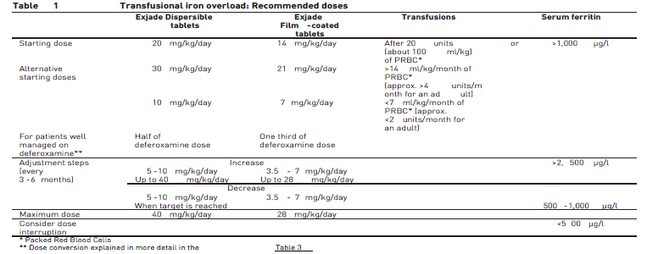
Important safety information (cont)
In patients treated with dose greater than 21 mg/kg, dose reductions in steps of 3.5 to 7 mg/kg should be considered when control has been achieved (e.g. serum ferritin levels persistently below 2,500 microgram/L and showing a decreasing trend over time). In patients whose serum ferritin level has reached the target (usually between 500 and 1,000 microgram/L), dose reductions in steps of 3.5 to 7 mg/kg should be considered to maintain serum ferritin levels within the target range. If serum ferritin falls consistently below 500 microgram/L, an interruption of treatment should be considered. As with other iron chelator treatment, the risk of toxicity of Exjade film-coated tablet may be increased when inappropriately high doses are given in patients with a low iron burden or with serum ferritin levels that are only slightly elevated (see section Warnings and precautions).
The corresponding recommended doses for both formulations are shown in Table 1.

Slide 17
Important safety information (cont)
Non-transfusion-dependent thalassemia (NTDT) syndromes
Exjade film-coated tablets
Dosage
Chelation therapy should only be initiated when there is evidence of iron overload (liver iron concentration (LIC) ≥5 mg Fe/g dry weight (dw) or serum ferritin consistently >800 microgram/L) [69]. In patients with no LIC assessment, caution should be taken during chelation therapy to minimize the risk of over-chelation.
Exjade film-coated tablets are a strength-adjusted formulation of deferasirox with higher bioavailability compared to the Exjade dispersible tablet formulation (see section Clinical Pharmacology). For patients who are currently on chelation therapy with Exjade dispersible tablet and switching to Exjade film-coated tablet, the dose of Exjade film-coated tablet should be 30% lower than the dose of Exjade dispersible tablet, rounded to the nearest whole tablet.
Starting dose
The recommended initial daily dose of Exjade film-coated tablet is 7 mg/kg body weight.
Dose adjustment
It is recommended that serum ferritin be monitored every month. Every 3 to 6 months of treatment, consider a dose increase in increments of 3.5 to 7 mg/kg if the patient’s LIC is ≥7 mg Fe/g dw, or serum ferritin is consistently >2,000 microgram/L and not showing a downward trend, and the patient is tolerating the drug well. Doses above 14 mg/kg are not recommended because there is no experience with doses above this level in patients with non-transfusion-dependent thalassemia syndromes.
In patients in whom LIC was not assessed and serum ferritin is ≤2,000 microgram/L, dosing should not exceed 7 mg/kg.
For patients in whom the dose was increased to >7 mg/kg, dose reduction is recommended to 7 mg/kg or less when LIC is <7 mg Fe/g dw or serum ferritin is ≤2,000 microgram/L.
Once a satisfactory body iron level has been achieved (LIC <3 mg Fe/g dw or serum ferritin <300 microgram/L), treatment should be interrupted. Treatment should be re-initiated when there is evidence from clinical monitoring that chronic iron overload is present.
The corresponding recommended doses for both formulations are shown in Table 2

Slide 18
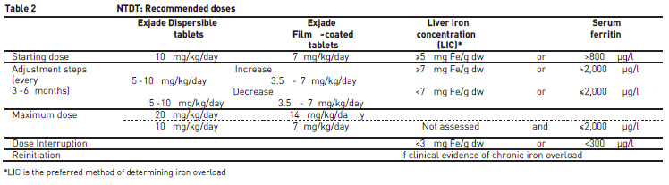
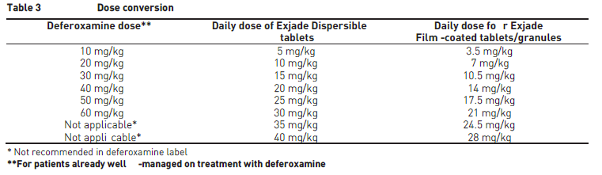
Important safety information (cont)
Transfusional iron overload and non-transfusion-dependent thalassemia syndromes
Information on dose conversion between DT and FCT, as well as deferoxamine is shown in Table 3 below.

Slide 19
Important safety information (cont)
Special populations:
Patients with renal impairment
Exjade film-coated tablets
Exjade film-coated tablet treatment must be used with caution in patients with serum creatinine levels above the age-appropriate upper limit of the normal range. Caution should especially be used in patients with creatinine clearance between 40 and less than 60 mL/min, particularly in cases where there are additional risk factors that may impair renal function such as concomitant medications, dehydration, or severe infections. The initial dosing recommendations for patients with renal impairment are the same as described above. Serum creatinine should be monitored monthly in all patients and if necessary daily doses can be reduced by 7 mg/kg (see section Warnings and precautions).
Patients with hepatic impairment
EXJADE has not been studied in patients with hepatic impairment and must be used with caution in such patients. The initial dosing recommendations for patients with hepatic impairment are the same as described above. Hepatic function in all patients should be monitored before the initiation of treatment, every 2 weeks during the first month and monthly thereafter (see section Warnings and Precautions).
Pediatric patients
The dosing recommendations for pediatric patients are the same as for adult patients. Changes in weight of pediatric patients over time must be taken into account when calculating the dose.
Elderly patients
The dosing recommendations for elderly patients are the same as described above. In clinical trials, elderly patients experienced a higher frequency of adverse reactions than younger patients and should be monitored closely for adverse reactions that may require a dose adjustment.

Slide 20
Important safety information (cont)
Method of administration
Exjade film-coated tablets
The film-coated tablets should be swallowed whole with some water. For patients who are unable to swallow whole tablets, Exjade film-coated tablets may be crushed and administered by sprinkling the full dose on soft food like yogurt or apple sauce (apple puree). The dose should be immediately and completely consumed, and not stored for future use.
Exjade film-coated tablets should be taken once a day, preferably at the same time each day, and may be taken on an empty stomach or with a light meal (see section Clinical Pharmacology)
Contraindications:
♦Hypersensitivity to deferasirox or to any of the excipients. ♦Creatinine clearance <40 mL/min or serum creatinine >2 times the age-appropriate upper limit of normal. ♦High risk MDS patients and patients with other hematological and non-hematological malignancies who are not expected to benefit from chelation therapy due to the rapid progression of their disease.
Women of child-bearing potential, pregnancy, breast-feeding and fertility: ♦Pregnancy: No clinical data on exposed pregnancies are available for deferasirox. Studies in animals have shown some reproductive toxicity at maternally toxic doses. The potential risk for humans is unknown. As a precaution, it is recommended that Exjade not be used during pregnancy unless clearly necessary. ♦Breast-feeding: It is not known if deferasirox is secreted into human milk. Breast-feeding while taking Exjade is not recommended. ♦Fertility: Exjade did not affect fertility or reproduction in rat studies even at toxic doses.
Warnings and precautions:
♦Caution in elderly patients due to a higher frequency of adverse reactions. ♦Caution in patients with creatinine clearance between 40 and less than 60 mL/min, particularly in cases where there are additional risk factors that may impair renal function. Monthly monitoring of creatinine clearance, serum creatinine and proteinuria: dose reduction may be needed in some cases of non-progressive increase in serum creatinine; Exjade should be interrupted if serum creatinine shows a progressive rise beyond the age-appropriate upper limit of normal. More frequent creatinine monitoring recommended in patients with an increased risk of renal complications. Rare reports of acute renal failure, some of which required dialysis or with fatal outcome. Reports of renal tubulopathy mainly in children with beta-

Slide 21
Important safety information (cont)
thalassemia and serum ferritin levels <1,500 microgram/L. ♦Exjade has not been studied in patients with hepatic impairment. Monitoring of serum transaminases, bilirubin and alkaline phosphatase: before the initiation of treatment, every 2 weeks during the first month and monthly thereafter. Exjade should be interrupted if persistent and progressive unattributable increase in serum transaminases levels. Post-marketing cases of hepatic failure have been reported. ♦Gastrointestinal (GI) irritation may occur. Upper GI ulceration and hemorrhage have been reported in patients, including children and adolescents. Multiple ulcers have been observed in some patients. There have been reports of ulcers complicated with GI perforation (including fatal outcome). There have been rare reports of fatal GI hemorrhages, especially in elderly patients who had advanced hematologic malignancies and/or low platelet counts. Caution in patients with platelet counts <50 x 109/L. ♦Severe cutaneous adverse reactions (SCARs) have been reported. Patients should be advised of the signs and symptoms of SCARs and be closely monitored. If any SCAR is suspected Exjade should be discontinued immediately and should not be reintroduced. ♦Skin rashes: Exjade should be interrupted if severe rash develops. ♦Discontinue if severe hypersensitivity reaction occurs. Exjade should not be reintroduced in patients who have experienced previous hypersensitivity reactions on deferasirox due to the risk of anaphylactic shock. ♦Annual ophthalmological/audiological testing. ♦Should not be used during pregnancy unless clearly necessary. ♦Not recommended when breast-feeding. ♦Product contains lactose.
Interactions:
♦Should not be taken with aluminium-containing antacids. ♦Caution when combined with drugs metabolized through CYP3A4 (e.g. ciclosporin, simvastatin, hormonal contraceptive agents, midazolam). ♦Increases in the dose of Exjade should be considered when concomitantly used with potent UGT inducers (e.g. rifampicin, phenytoin, phenobarbital, ritonavir). ♦Careful monitoring of glucose levels should be performed when repaglinide is used concomitantly with Exjade Interaction with other CYP2C8 substrates like paclitaxel cannot be excluded. ♦Consider monitoring of theophylline concentration and possible theophylline dose reduction. Interaction with other CYP1A2 substrates may be possible. ♦Caution when combined with drugs with ulcerogenic potential (e.g. NSAIDS, corticosteroids, oral bisphosphonates) or with anticoagulants. ♦Caution should be exercised when deferasirox is combined with busulfan and the patient’s plasma concentrations of busulfan should be monitored.
Adverse reactions:
♦Very common: blood creatinine increased.
♦Common: nausea, vomiting, diarrhoea, abdominal pain, abdominal distension, constipation, dyspepsia, rash, pruritus, transaminases increased, proteinuria, headache.
♦Uncommon: anxiety, sleep disorder, dizziness, cataracts, maculopathy, deafness, laryngeal pain, gastrointestinal haemorrhage, gastric ulcer (including multiple ulcers), duodenal ulcer, gastritis, acute pancreatitis, hepatitis, cholelithiasis, pigmentation disorder, renal tubular disorder (Fanconi syndrome), pyrexia, oedema, fatigue.
♦Rare: optic neuritis, drug reaction with eosinophilia and systemic symptoms (DRESS), erythema multiforme, oesophagitis.

Slide 22
Important safety information (cont)
♦Adverse drug reactions from post-marketing (frequency unknown): renal tubular necrosis, gastrointestinal perforation, Stevens-Johnson syndrome, toxic epidermal necrolysis (TEN), acute renal failure, tubulointerstitial nephritis, hepatic failure, hypersensitivity vasculitis, urticaria, alopecia, hypersensitivity reaction (including anaphylactic reaction and angioedema), aggravated anaemia and cytopenia (relationship with Exjade uncertain).
Package
Exjade® Film-coated tablet 90 mg: Box, 3 blisters @ 10 film-coated tablets, Reg. No. DKI1867509517A1
Exjade® Film-coated tablet 180 mg: Box, 3 blisters @ 10 film-coated tablets, Reg. No. DKI1867509517B1
Exjade® Film-coated tablet 360 mg: Box, 3 blisters @ 10 film-coated tablets, Reg. No. DKI1867509517C1
HARUS DENGAN RESEP DOKTER
To be dispensed only on the prescription of a physician
Manufactured by Novartis Pharma Stein AG, Stein, Switzerland for Novartis Pharma AG, Basel, Switzerland.
Imported by PT Novartis Indonesia, Jakarta, Indonesia.

