Slide 1
Nature of Immune Thrombocytopenia (ITP)
(Name of Speaker)
© Reproduction of the figures/tables/images in the slides marked with this symbol require copyright permission from the relevant publishers

Slide 2
Topics
Definition and epidemiology
Aetiology and pathophysiology
Signs and symptoms of ITP
Diagnosis
Prognosis
Impact of ITP
ITP treatment overview
  Treatment guidelines and management decisions
  Treatment options

Slide 3
DEFINITION AND EPIDEMIOLOGY

Slide 4
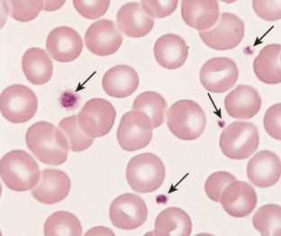
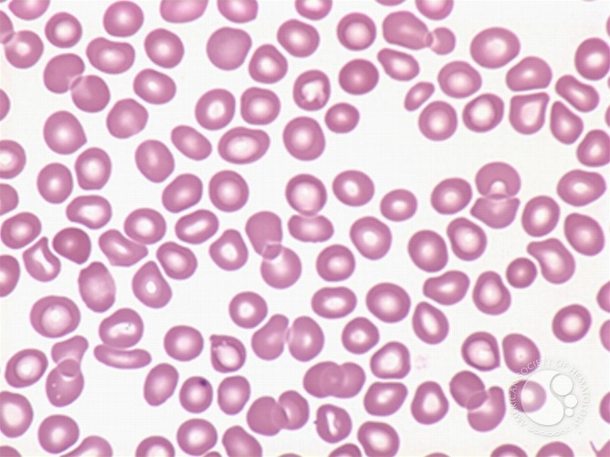
ITP
Immune-mediated acquired disease of adults and children¹
ITP is characterised by:
  A low platelet count
  (<100 x 10⁹/L, transient or persistent)¹
  An increased risk of bleeding due to
  impaired clotting mechanism²
Currently no definitive diagnostic
criteria exist for primary ITP
  Considered a diagnosis of exclusion
  Thrombocytopenia may occur
  secondary to other conditions, such
  as lupus, leukaemia, HIV, HCV³
Normal peripheral blood smear
© 2010 by Mosby inc, an affiliate of Elsevier
ITP peripheral blood smear http://imagebank.hematology.org/image/2820/immune-thrombocytopenic-purpura--1?type=upload
HCV, hepatitis C virus; HIV, human immunodeficiency virus
1. Rodeghiero F, et al. Blood 2009; 113: 2386–93; 2. Chang M, et al. Blood 2003; 102: 887–95; 3. Cines D, Blanchette V. N Engl J Med 2002; 346: 995−1008
©
Notes:
ITP is an immune-mediated acquired disease associated with a low platelet count and an increased risk of bleeding¹
Platelets play an important role in coagulation. An insufficient number of platelets can adversely affect the body’s ability to control bleeding from cuts and wounds. ITP is characterised by a transient or persistent decrease in the platelet count and, dependent upon the degree of thrombocytopenia, an increased risk of bleeding.^{2,3}
Primary ITP is characterised by isolated thrombocytopenia (peripheral blood platelet count <100 x 10⁹/L) in the absence of other causes or disorders that may be associated with thrombocytopenia.^{1,4} The diagnosis of primary ITP remains one of exclusion;¹ no robust clinical or laboratory parameters are currently available to establish its diagnosis with accuracy.¹
Secondary ITP occurs in association with other conditions, such as systemic lupus erythematosus, immunodeficiency states (e.g. immunoglobulin A deficiency), lymphoproliferative disorders (e.g. chronic lymphocytic leukaemia, large granular lymphocytic leukaemia, and lymphoma); infection with human immunodeficiency virus (HIV) or hepatitis C virus (HCV), and can be induced by certain medications, such as heparin and quinidine.¹
Normal peripheral blood smear shows red blood cells and arrows to platelets. Sourced from: http://studydroid.com/printerFriendlyViewPack.php?packId=474391 and cited from Hoffbrand AV: Color Atlas: Clinical Hematology, 3rd ed. St. Louis, Mosby, 2000, p 22, Fig. 1-62. Copyright permission may be required.
ITP peripheral blood smear shows a lack of platelets. Sourced from: http://imagebank.hematology.org/image/2820/immune-thrombocytopenic-purpura--1?type=upload (Author: Peter Maslak). Copyright permission may be required.
References
Rodeghiero F, et al. Blood 2009; 113: 2386–93
Stasi R, Provan D. Mayo Clin Proc 2004; 79: 504–22
Chang M, et al. Blood 2003; 102: 887–95
Cines D, Blanchette V. N Engl J Med 2002; 346: 995−1008

Slide 5
ITP duration and classification
Acute = 0 to 6 months
Diagnosis
3 months
12 months
Newly diagnosed ITP
Persistent ITP
Chronic ITP
                Rodeghiero F, et al. Blood 2009; 113: 2386–93
Notes:
The prognosis for ITP varies considerably with classification
‘Acute ITP’ was used to describe a self-limited form of the disease of approximately 6 months duration. However, an expert panel proposed in 2009 that this term be avoided due to its vague nature and retrospective definition. The International Working Group proposed to split ITP into 3 stages: newly diagnosed, persistent and chronic.
The distinction between these stages is important as spontaneous remission may still occur during the ‘persistent’ stage. Therefore, it seems logical to avoid an aggressive therapeutic approach during this period (e.g. splenectomy and rituximab).
ITP can become severe at any stage: ITP is considered severe if bleeding symptoms require treatment at diagnosis or additional therapeutic intervention.
Reference
Rodeghiero F, et al. Blood 2009; 113: 2386–93

Slide 6
Prevalence and incidence
ITP is a rare condition: overall incidence among adults is estimated at 3.3 per 100,000 person-years¹
  In Europe, incidence of 1.6−3.9 per 100,000 adults/year¹
  In the USA, age-adjusted prevalence: 9.5 per 100,000 persons²
  Higher incidence in women versus men³
    Male:female ratio increases with age
  Higher incidence at older ages³
In children:
  Incidence of 2.2−5.3 per 100,000 children/year (Europe & USA)¹
                Terrell DR, et al. Am J Hematol 2010; 85: 174–80; 2. Segal JB, Powe NR. J Thromb Haemost 2006; 4: 2377-83;
                3. Schoonen W, et al. Br J Haematol 2009; 145: 235–44.
Notes:
ITP is a rare condition that is more likely to affect adult women than men
A literature search to identify primary data for the incidence of ITP identified eight articles (mainly from Europe) reporting ITP incidence in children and three (all European) in adults.¹ ITP incidence in children ranging from 2.2 to 5.3 per 100,000 children/year was reported in the four strongest paediatric publications; and a range of 1.6–3.9 was reported for adults.¹
An analysis of healthcare utilisation data from a US state, Maryland, provided an indication of ITP prevalence in the USA.²
References
Terrell DR, et al. Am J Hematol 2010; 85: 174–80
Segal JB, Powe NR. J Thromb Haemost 2006; 4: 2377–83

Slide 7
AETIOLOGY AND PATHOPHYSIOLOGY

Slide 8
ITP involves diverse autoimmune mechanisms
Although the exact pathology behind ITP remains unclear, recent advances have indicated two broad routes
Immune dysfunction may play a key role in these processes,
including B-cell abnormalities, a T-cell disorder, abnormality of thrombopoiesis, or increased mononuclear phagocyte activation¹
Increased platelet destruction¹
Decreased platelet production²
“Concepts… have shifted from the traditional view of increased platelet destruction mediated by auto-antibodies to more complex mechanisms where both impaired platelet production and T-cell-mediated effects play a role.”³
1. Cooper N, et al. Br J Haematol 2006; 133: 364–74; 2. Gernsheimer T. Eur J Haematol Suppl 2008; 80: 3–8;
3. Provan D, et al. Blood 2010; 115: 168–86
Notes:
The pathogenesis of ITP is related to increased platelet destruction¹ and decreased platelet production.²
ITP was traditionally considered to be an heterogeneous disease characterised by increased platelet destruction and thrombocytopenia. However, advances in the understanding of ITP pathophysiology have shown that this disorder results from both increased platelet destruction and decreased platelet production.^{1,2}
Immune dysfunction is thought to play a key role in both these processes, though the exact pathology remains unknown. For example, it is unclear whether ITP is initially caused by a B-cell abnormality, a T-cell disorder, an abnormality of thrombopoiesis, or even from increased mononuclear phagocyte activation.¹
References
1. Cooper N, et al. Br J Haematol 2006; 133: 364–74
2. Gernsheimer T. Eur J Haematol Suppl 2008; 80: 3–8

Slide 9
Disruption of platelet destruction/production in ITP involves multiple immunological pathways
Increased platelet destruction
Decreased platelet production
Antibodies and B cells¹
Accelerate platelet clearance via
macrophage activation
Interfere with platelet production
via a reduction in megakaryocyte
maturation
Potentially alter platelet function
T cells^{2,3}
T-cell-dependent response Th1/Th2³
Treg deficit, impaired control of
B cells²
T-cell-mediated cytotoxicity, potentially causing inhibition of megakaryocytes in bone marrow⁴
                Th, T helper cell; Treg, regulatory T-cell
                Stasi R, et al. Thromb Haemost 2008; 99: 4–13; 2. Chong B, et al. Blood 2010; 116: 4388–90;
                3. Cooper N, et al. Br J Haematol 2006; 133: 364–74; 4. Semple JW, Provan D. Curr Opin Hematol 2012; 19: 357–62
Notes:
The pathogenesis of ITP is related to increased platelet destruction¹ and decreased platelet production.¹
As an autoimmune disorder, ITP involves T and B cells recognising platelet antigens and initiating antiplatelet destructive mechanisms such as peripheral Fc receptor-mediated phagocytosis in the spleen or megakaryocyte destruction/inhibition within the bone marrow.²
Antiplatelet activity in ITP patients includes platelet antigen presentation to macrophages, activation of macrophages by inflammatory cytokines, interaction of macrophages with T cells, stimulation of cytotoxic T cells and activation of T cells in the bone marrow, and interactions between T and B cells (via regulatory T cells [Treg]).³
In addition, platelet-associated antibody levels inversely correlate with platelet production, suggesting that platelet antibodies impair platelet production (thrombopoiesis).⁴
References
1. Cooper N, et al. Br J Haematol 2006; 133: 364–74
2. Semple JW, Provan D. Curr Opin Hematol 2012; 19: 357–62
3. Chong B, et al. Blood 2010; 116: 4388–90
4. Gernsheimer T. Eur J Haematol Suppl 2008; 69: 3–8

Slide 10
Underlying mechanisms of platelet destruction and production in ITP are complex
Tc cell
Megakaryocyte
Tc-cell-mediated
platelet destruction
Y
Y
Y
Y
X
Y
Y
Y
Y
X
Y
X
Y
Y
Y
Y
Y
Y
Y
Y
Y
Y
Y
Y
Y
Y
Platelets
Y
Impaired megakaryocyte maturation
Reduced platelet production
Y
Platelet
phagocytosis
Y
Y
Y
Y
Y
CD80
Epitope spreading
Platelet auto-antibody production
CD28
CD80
CD28
Macrophage
(APC cell)
Th cell
B cell
Treg
MHC II
TCR
CD40 CD154
CD154 CD40
IL-2
IFN-γ
APC, antigen-presenting cell; IFN, interferon; IL, interleukin; MHC, major histocompatibility complex; Tc, cytotoxic T-cell;
TCR, T-cell receptor; Th, helper T-cell; Treg, regulatory T-cell
Stasi R, et al. Thromb Haemost 2008; 99: 4–13
©
Notes:
The control mechanisms that underlie both platelet destruction and production in ITP are complex, and may involve interactions between B cells, T-cells, regulatory T cells (Treg) and macrophages
Reference
Stasi R, et al. Thromb Haemost 2008; 99: 4–13

Slide 11
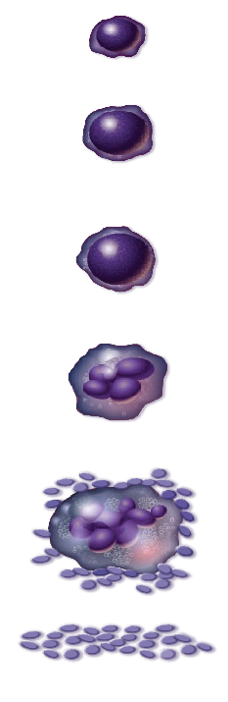
Reduced platelet production and the involvement of TPO
TPO is a potent endogenous haematopoietic growth factor that plays an integral role in platelet production^{1–3}
  Produced primarily in the liver at constitutive rate¹
  Influences proliferation/differentiation of megakaryocytes²
Drives platelet production via TPO-R⁴
Decline in platelet mass causes increase in TPO levels to maintain platelet levels
  TPO levels remain elevated during persistent thrombocytopenia¹
Stem cell
TPO
Bilineal progenitor cell
TPO
Committed megakaryocyte
progenitor cell
TPO
Immature megakaryocyte
TPO
Mature megakaryocyte
Platelets
TPO, thrombopoietin; TPO-R, thrombopoietin receptor
1. Kuter D, Begley C. Blood 2002; 100: 3456–69; 2. Kaushansky K. N Engl J Med 1998; 339: 746–54; 3. Wolber E, Jelkmann W. News Physiol Sci 2002; 17: 6–10; 4. Kuter D, et al. Blood 2007; 109: 4607–16; Figure adapted from Kaushansky K. N Engl J Med 1998; 339: 746–54
©
Notes:
TPO: induces megakaryocyte proliferation and platelet production
TPO is a potent endogenous haematopoietic growth factor that influences platelet production through its effect on proliferation/differentiation of megakaryocytes from bone marrow progenitor cells.^{1,2} It is the primary regulator of megakaryocyte growth and platelet number.
TPO is produced primarily in the liver at a constitutive rate and removed from the circulation by binding to the TPO receptor (TPO-R) also known as c-Mpl.¹ TPO-Rs are located on the surface of stem cells, progenitor cells, megakaryocytes and platelets.³ When there are fewer platelet receptors with which to bind, TPO levels rise and more TPO is free to bind to megakaryocytes and other platelet precursors, driving their differentiation into platelets.¹
TPO levels usually increase in response to a reduction in platelet mass and remain elevated during persistent thrombocytopenia. Although hepatic transcription and translation of the TPO gene seems to be constant, the majority of studies suggest that the circulating platelet mass directly influences circulating levels of TPO.¹ The ‘normal’ range for platelet count is relatively broad: 150,000–400,000/L; however, an individual’s platelet count is maintained within a much narrower range. A constant balance of thrombopoiesis – with platelet senescence and consumption – is required to maintain this narrow range.³
References
Kuter D, Begley C. Blood 2002; 100: 3457–69
Kaushansky K. N Engl J Med 1998; 339: 746–54
Wolber E, Jelkman W. News Physiol Sci 2002; 17: 6–10

Slide 12
SIGNS AND SYMPTOMS OF ITP

Slide 13
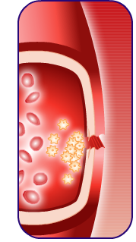
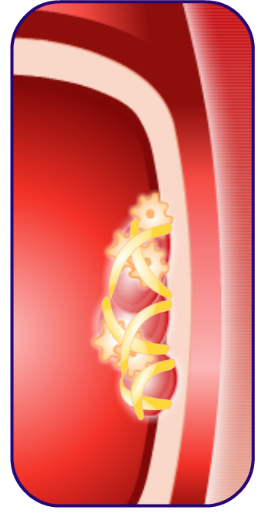
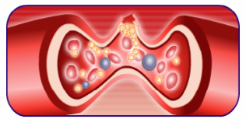
Platelets play a vital role in haemostasis
Reduced platelet count in ITP means fewer platelets contribute to haemostasis
Platelets prevent blood
loss by:
  Releasing substances that constrict blood vessels
  Forming platelet plugs
  Releasing clot-promoting chemicals
1
Damage to artery wall
Platelets
Red blood cells
Vascular endothelium
2
3
Damage to artery wall
Platelets
Platelets
Clot
Fibrin
                Guyton A, et al. Textbook of Medical Physiology 2006; Vol. 11
Notes:
Platelets play a vital role in haemostasis and therefore thrombocytopenia can result in a spectrum of signs and symptoms¹
Platelets are essential in preventing blood loss from vascular damage and act via several mechanisms, such as vascular constriction, platelet plug formation and blood coagulation.¹
Vascular constriction
Platelets are attracted to the site of injury and adhere to collagen fibres in the torn vessel wall. These platelets release vasoconstrictors that cause ‘smaller’ blood vessels to contract, reducing blood flow and minimising blood loss.¹ Low platelet counts (as seen in ITP) can result in decreased vasoconstriction and therefore increased bleeding.²
Platelet plug formation
Usually platelets release adenosine diphosphate and thromboxane, which activate other platelets at the injury site. Platelets become sticky, accumulate, and form a platelet plug.¹ In patients with primary haemostatic disorders, such as ITP, one of the reasons for bleeding is the failure of this platelet plug to form.¹
Blood coagulation
Bleeding is halted by the formation of a blood clot. Fibrin forms a net over the injury site. Platelets then secrete fibrin-stabilising factor (factor XIII), which, when activated, strengthens the fibrin netting.¹ If platelet reactions are impaired, the fibrin net is weakened, resulting in the bleeding and bruising symptoms seen in ITP patients.³
References
Guyton A, et al. Textbook of Medical Physiology 2006; Vol. 11; p457
Merhi Y, et al. Arterioscler Thromb Vasc Biol 1997; 17: 1185−91
Rand M, et al. Acta Paediatr Suppl 1998; 424: 57−60

Slide 14
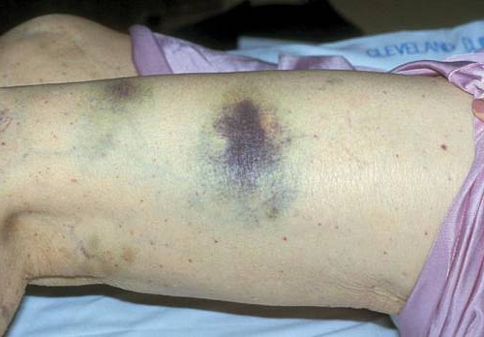
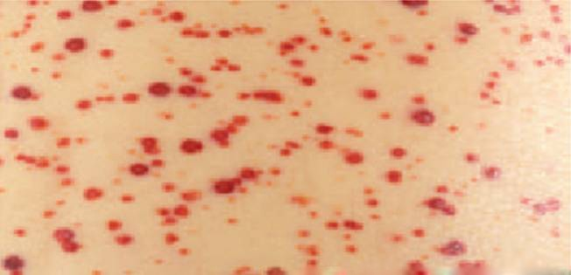
Clinical presentation of ITP varies
Dependent on the severity of thrombocytopenia, the clinical presentation of ITP varies¹
  Most patients are asymptomatic but may complain of fatigue and bruising easily
  As platelet counts fall, symptoms become more severe and may include:
    purpuric skin lesions
    cutaneous bleeding
    epistaxis
    gingival or gastrointestinal bleeding
    haematuria or menorrhagia
  Thromboembolic event risk increased²
Purpura (reddish purple spots)ª
Petechiae
Actual scale:
1 cm
2 cm
3 cm
                ªPhoto sourced from: Deitcher S. In Atlas of Clinical Hematology. Edited by JO Armitage. Philadelphia, Current Medicine, 2004. ^{b}Petechiae image sourced from: http://www.slideserve.com/carter/supplemental-appendix-4 (accessed Dec 2015)
                Cines D, McMillan R. Annu Rev Med 2005; 56: 425–42; 2. Sarpatwari A, et al. Haematologica 2010; 95: 1167–75
©
Notes:
ITP is a rare condition that can be asymptomatic or associated with mild bruising or petechiae through to severe mucocutaneous bleeding
Clinical presentation varies considerably. Some patients may be asymptomatic or have mild bruising and petechiae, whereas others can have more severe mucocutaneous bleeding.^{1,2} Most ITP patients are asymptomatic but may complain of fatigue and easy bruising.²
However, as platelet counts fall (especially at levels <10 x 10⁹/L), symptoms become more severe and may include purpuric skin lesions, severe cutaneous bleeding, epistaxis, gingival bleeding, haematuria or menorrhagia.² Purpura is a general term for the lesions that develop in the skin of patients with ITP and other bleeding disorders. The lesions develop over several days and are the result of bleeding from small vessels near the surface of the skin. Lesions may be small or pinpoint (petechiae) or larger haemorrhages into the skin (ecchymoses).²
ªPhoto from: Deitcher S. In Atlas of Clinical Hematology. Edited by JO Armitage. Philadelphia, Current Medicine, 2004. https://books.google.co.uk/books?id=FPPw8tQc7yAC&pg=PP6&lpg=PP6&dq=Atlas+of+Clinical+Hematology.+Current+Medicine,+2004.&source=bl&ots=H59Mmt_HyC&sig=InMj8FUZhKrzdz0PQ6DEplWAadc&hl=en&sa=X&ved=0ahUKEwj49Oy60NvJAhWHRhQKHZpyBB8Q6AEIITAB#v=onepage&q=Atlas%20of%20Clinical%20Hematology.%20Current%20Medicine%2C%202004.&f=false (accessed December 2015)
^{b}Petechiae image sourced from: http://www.slideserve.com/carter/supplemental-appendix-4 (accessed December 2015)
References
Stasi R, Provan D. Mayo Clin Proc 2004; 79: 504–22
Cines D, McMillan R. Annu Rev Med 2005; 56: 425–42

Slide 15
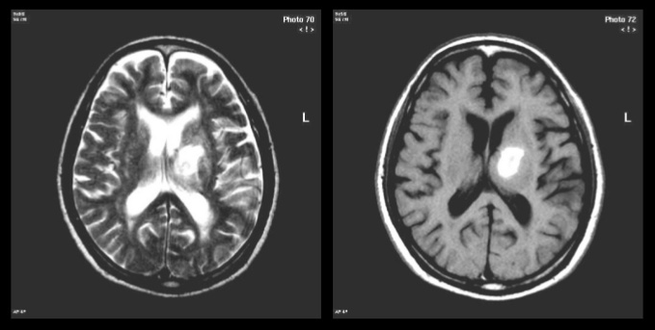
Severe clinical features
At very low platelet levels (<5−10 x 10⁹/L) severe purpuric lesions and potentially fatal intracranial haemorrhages can occur
Chronic intracranial haemorrhage
                Cines D, McMillan R. Annu Rev Med 2005; 56: 425–42; Intracranial haemorrhage Magnetic Resonance Image from: http://www.slideshare.net/ghalan/ct-mri-of-central-nervous-system (accessed June 2016)
©
Notes:
At platelet levels <10 x 10⁹/L there is a risk of severe clinical events
The most serious of these (potentially fatal) is intracranial haemorrhage. Although rare, severe bleeding events are associated with a 5% lifetime risk of fatality, mainly due to intracranial haemorrhage.¹ The 5-year mortality rate for severe ITP ranges from 2.2% (<40 years of age) to 47.8% (>60 years of age),² and the overall mortality is estimated to be 60% higher in adults with ITP than in healthy, age- and gender-matched cohorts.³
Intracranial haemorrhage Magnetic Resonance Image from: http://www.slideshare.net/ghalan/ct-mri-of-central-nervous-system (accessed June 2016). Copyright permission may be required.
References
1. George J, et al. Blood 1996; 88: 3–40
2. Cines D, Blanchette V. N Engl J Med 2002; 346: 995–1008
3. Schoonen W, et al. Br J Haematol 2009; 145: 235–44

Slide 16
DIAGNOSIS

Slide 17
Guidelines for diagnosis of ITP
ITP remains a diagnosis of exclusion of other conditions or factors that cause thrombocytopenia¹
Assessment of the following is needed to diagnose ITP:¹
  Patient and family history
  Physical examination
  Complete blood count
  Peripheral blood film
  Other laboratory investigations
There is no robust clinical or laboratory test that can establish a diagnosis with accuracy¹
A platelet count <100 x 10⁹/L has been defined as the threshold for diagnosis²
ITP remains a diagnosis of exclusion of other conditions or factors that cause thrombocytopenia¹
Assessment of the following is needed to diagnose ITP:¹
  Patient and family history
  Physical examination
  Complete blood count
  Peripheral blood film
  Other laboratory investigations
There is no robust clinical or laboratory test that can establish a diagnosis with accuracy¹
A platelet count <100 x 10⁹/L has been defined as the threshold for diagnosis²
Results do not suggest other aetiologies for thrombocytopenia¹
1. Provan D, et al. Blood 2010; 115: 168–86; 2. Rodeghiero F, et al. Blood 2009; 113: 2386–93
Notes:
The diagnosis of ITP remains one of exclusion of other causes of thrombocytopenia, with no robust clinical or laboratory test that can establish a diagnosis with accuracy. Patients are diagnosed with ITP when their clinical history, physical examination, complete blood count, and peripheral blood smear indicates thrombocytopenia with no other apparent aetiology.
Bone marrow examination is also recommended in adults with systemic symptoms or abnormal signs at diagnosis or in those aged 60 years or over, and in patients scheduled for splenectomy.
Testing for Helicobacter pylori infection should be considered in the work-up for adult ITP patients, where it may be of clinical benefit. Human immunodeficiency virus (HIV) and hepatitis C virus (HCV) infection-associated thrombocytopenia can be clinically indistinguishable from primary ITP and can occur several years before patients develop other symptoms. Therefore, routine serological testing for these infections is recommended in adult patients with suspected ITP.
Testing for other acute and persistent infections, such as parvovirus or cytomegalovirus, may also be of potential benefit.
Baseline immunoglobulin (Ig) levels should be measured in adults and considered in children with ITP. For children with persistent or chronic ITP, Ig levels should be measured as part of a reassessment evaluation.
If treatment with anti-D is being considered, blood group rhesus typing and direct antiglobulin tests are also recommended.
Reference
Provan D, et al. Blood 2010; 115: 168–86

Slide 18
Factors that can cause thrombocytopenia
Possible causes of thrombocytopenia to consider include:
  Lupus erythematosus, infection (HIV, HCV), thrombotic thrombocytopenic purpura
  Hereditary thrombocytopenia: absent radius syndrome,
  radio-ulnar synostosis, congenital amegakaryocytic thrombocytopenia, Wiskott-Aldrich Syndrome, MYH9-associated thrombocytopenia, Bernard-Soulier Syndrome
  Vaccinations and transfusions
  Medication/drugs/diet (e.g. platelet-lowering treatments, alcohol, vitamin deficiency, quinine from tonic water)
  Liver disease
  Other bone marrow disease/leukaemia
HCV, hepatitis C virus; HIV, human immunodeficiency virus
                Provan D, et al. Blood 2010; 115: 168–86
Notes:
Diagnosis of ITP is primarily by exclusion
The diagnosis of ITP remains one of exclusion of other causes of thrombocytopenia, with no robust clinical or laboratory test that can establish a diagnosis with accuracy.
Patients are diagnosed with ITP when their clinical history, physical examination, complete blood count, and peripheral blood smear indicates thrombocytopenia with no other apparent aetiology.
Reference
Provan D, et al. Blood 2010; 115: 168–86

Slide 19
PROGNOSIS

Slide 20
Clinical features and disease course of ITP
Clinical features of ITP in adults
Chronic in most patients¹
No direct precipitating illness^{1,2}
Spontaneous remission in <10% of patients^{1,3}
5% lifetime risk of fatality, mainly due to intracranial haemorrhage⁴ 60% higher mortality rate than gender- and age-matched healthy cohorts⁵
Twice as many females as males affected⁶
Increased risk of infection requiring hospitalisation (15% vs 4% in general population)⁷
1. Stasi R, Provan D. Mayo Clin Proc 2004; 79: 504–22; 2. British Committee for Standards in Haematology General Haematology Task Force. Br J Haematol 2003; 120: 574–96; 3. Cines D, Bussel J. Blood 2005; 106: 2244–51; 4. George J, et al. Blood 1996; 88: 3–40;
5. Schoonen W, et al. Br J Haematol 2009; 145: 235–44; 6. Cines D, Blanchette V. N Engl J Med 2002; 346: 995–1008; 7. Nørgaard M, et al. Blood 2011; 117: 3514–20
Notes:
The clinical features and disease course in adults with ITP
ITP in adults is generally chronic and the onset is often insidious.¹ Furthermore, approximately twice as many women as men are affected.² There is usually no direct precipitating illness,^{1,3} and spontaneous remission is only seen in <10% of patients.^{3,4} Adult-onset ITP is associated with a 5% lifetime risk of fatality, mainly due to intracranial haemorrhage.⁵ The mortality rate has been shown to be 60% higher in adults with ITP than in healthy, age- and gender-matched cohorts.⁶
References
1. British Committee for Standards in Haematology General Haematology Task Force. Br J Haematol 2003; 120: 574–96
2. Cines D, Blanchette V. N Engl J Med 2002; 346: 995–1008
3. Stasi R, Provan D. Mayo Clin Proc 2004; 79: 504–22
4. Cines D, Bussel J. Blood 2005; 106: 2244–51
5. George J, et al. Blood 1996; 88: 3–40
6. Schoonen W, et al. Br J Haematol 2009; 145: 235–44
20

Slide 21
Mortality of chronic ITP in adults
Mortality is increased relative to the general population
Study | Patients (n) | Mortality/ Fatal bleeding
Stasi, 1995¹ | 208 | 5.3% mortality 2.4% fatal bleeding
George, 1996*² | 1761 | 5% fatal bleeding (lifetime)
Portielje, 2001³ | 152 | 1.3−4.2x mortality risk of the general population
Nørgaard, 2011⁴ | 407 | 1.4% intracranial bleeding rate and 24.3% mortality (5-year)
Frederiksen, 2014⁵ | 221 | Mortality 1.5-fold higher than the general population
                *Meta-analysis study
                Stasi R, et al. Am J Med 1995; 98: 436−42; 2. George J, et al. Blood 1996; 88: 3–40; 3. Portielje J, et al. Blood 2001; 97: 2549–54
                4. Nørgaard M, et al. Blood 2011; 117: 3514–20; 5. Frederiksen H, et al. Br J Haematol 2014; 166: 260–7
Notes:
Mortality of chronic ITP in adults is increased relative to the general population
The mortality risk associated with chronic ITP increases with the severity of thrombocytopenia (4.2x mortality risk in patients with persistent platelet counts <30 x 10⁹/L compared with the general population).¹ Fatal bleeding events account for a large percentage of overall mortality in this ITP population.^{1–4}
References
1. Portielje, J et al. Blood 2001; 97: 2549–54
2. George J, et al. Blood 1996; 88: 3–40
3. Stasi R, et al. Am J Med 1995; 98: 436−42
4. Nørgaard M, et al. Blood 2011; 117: 3514–20

Slide 22
Risk of fatal/severe bleeding in chronic ITP
A major risk factor for severe bleeding is the presence of other conditions that carry an inherent bleeding risk,
e.g. hypertension or cerebrovascular disease¹
Fatal haemorrhage rates also increase with age:²
  0.004 per patient-year in patients <40 years
  0.012 per patient-year in patients 40–60 years
  0.130 per patient-year in patients >60 years
The risk of thromboembolic events also increased³
                1. George J. Thromb Haemost 2006; 4: 1664–72; 2. Cohen Y, et al. Arch Intern Med 2000; 160: 1630–8;
                3. Sarpatwari A, et al. Haematologica 2010; 95: 1167–75
Notes:
Primary risk factors for bleeding events in ITP include increasing age and concomitant conditions¹
The risk of serious/fatal haemorrhage with chronic ITP increases with age (0.130 per patient-year in patients >60 years compared with 0.004 per patient-year in those <40 years).¹ Bleeding risks are also greater in older patients due to the presence of other conditions that themselves carry an inherent risk of bleeding, such as hypertension or cerebrovascular disease.²
References
1. Cohen Y, et al. Arch Intern Med 2000; 160: 1630–38
2. George J. Thromb Haemost 2006; 4: 1664–72

Slide 23
IMPACT OF ITP

Slide 24
Impact of ITP: cost and healthcare burden
Chronic ITP exerts a considerable healthcare burden
  Laboratory/physician visits
  Emergency department visits (acute bleeding episodes)
  Hospitalisation
  ITP medication/surgery/treatment for side effects
Treatment and hospitalisation are the main
cost-driving factors:
  US medical procedures/prescription drugs:
  ~$1,000 per patient-year
  US hospitalisation: ~$5,000 per patient-year
                Saleh M, et al. Curr Med Res Opin 2009; 25: 2961−9
Notes:
ITP exerts a considerable healthcare burden, primarily driven by the cost of treatment of the disease (chronic) and of side effects (acute) and hospitalisations
As a chronic condition, ITP exerts a considerable healthcare burden, arising from frequent laboratory and physician visits, treatment for the chronic condition, treatment for acute bleeding episodes, treatment for adverse events arising from other treatments, emergency department visits and hospitalisations for severe bleeding episodes. A study in US patients with ITP showed that the primary driving factors behind the healthcare costs were medical, diagnostic and treatment procedures ($913 per patient-year), prescription drugs ($299 per patient-year) and hospitalisations ($4,986 per patient-year).
Reference
Saleh M, et al. Curr Med Res Opin 2009; 25: 2961–9

Slide 25
Chronic ITP negatively impacts quality of life
Even mild thrombocytopenia can result in bruising, mucosal bleeding and fatigue,¹ which can negatively affect a patient’s quality of life
Some patients have reported depression, which may
be caused by a lack of platelets that carry serotonin to the brain²
In addition to ITP-related symptoms, adverse events of many treatments may be worse than bleeding symptoms for some patients³
                Stasi R, Provan D. Mayo Clin Proc 2004; 79: 504–22; 2. Profit L. Core Evidence 2006; 1: 221–31;
                3. George J. Thromb Haemost 2006; 4: 1664–72
Notes:
Even mild thrombocytopenia can result in bruising, mucosal bleeding (e.g. oral or gastrointestinal) and fatigue, ¹ which can negatively affect a patient’s quality of life (QoL)
In addition, ITP is often accompanied by fatigue and muscle aches. Patients (and their families) may also be distressed by frequent bruising and bleeding episodes, such as nosebleeds that are difficult to stop and bleeding gums during normal dental care.² These bleeding episodes are inconvenient (e.g. removing blood stains from clothes) and may disrupt the patient’s lifestyle by preventing them from partaking in everyday activities.²
Some patients have reported depression, which may be caused by a lack of platelets that carry the neurotransmitter serotonin to the brain.²
Adverse events that effect QoL may occur with ITP treatments.³
References
1. Stasi R, Provan D. Mayo Clin Proc 2004; 79: 504–22
2. Profit L. Core Evidence 2006; 1: 221–31
3. George J. Thromb Haemost 2006; 4: 1664–72

Slide 26
The patient’s perspective: impact on daily activities
ITP patient focus groups and surveys showed that ITP:¹
Impacted on work | 87%
Impacted on social activities | 67%
Symptoms affected functional health, particularly daily activities | 87%
Induced some fear of bleeding | 88%
Web-based questionnaire of 122 adults with chronic ITP:²
  11% felt that their disease impacted on school/occupational activities
  7% felt that their disease impacted on daily non-occupational activities
                1. Mathias S, et al. Health Qual Life Outcomes 2008; 6: 13; 2. Matzdorff AC, et al. PLoS One 2011; 6: e27350
Notes:
Patient focus groups, surveys and questionnaires reveal that ITP impacts work, social activities, functional and emotional health
In 2008, a study involving literature searches and focus groups with adult ITP patients was conducted to identify areas of health-related quality of life (HRQoL) affected by ITP.¹ Published literature was reviewed to identify key HRQoL issues and existing questionnaires used to assess HRQoL. Focus group transcripts were reviewed, and common themes were extracted by grouping conceptual categories that described the impact on HRQoL. The main determinants for HRQoL were (1) signs and symptoms and (2) treatment effects, with five HRQoL domains identified: (1) emotional health, (2) functional health, (3) work life, (4) social and leisure activities, and (5) reproductive health.
In 2011, the results of a web-based questionnaire were published.² Patients included in the analysis had chronic ITP (lasting >12 months) and were 18 years of age or older. The percentage of patients who felt affected by ITP during school/occupational activities, or other daily activities, was lower than that reported by Mathias et al.¹ This could be explained by the larger study population included in the questionnaire (n=122),² compared with the focus groups (n=15).¹ The disease characteristics of the study populations may also be different as neither study had any specific clinical requirements for participation.
References
Mathias S, et al. Health Qual Life Outcomes 2008; 6: 13
Matzdorff AC, et al. PLoS One 2011; 6: e27350

Slide 27
The patient’s perspective: effect of ITP on work
Web-based survey of 1002 adults with ITP and 1031 age- and gender-matched controls
 | Patients with ITP | Controls | P-value
Ever taken sick leave | 56% | 30% | <0.001
>1 primary care visit in the past month | 20% | 11% | <0.001
Work days missed in past month | 2.2 | 1.7 | NS
                NS, not significant
                Tarantino M, et al. Curr Med Res Opin 2010; 26: 319–28
Notes:
A web-based survey revealed that adults with ITP require more physician visits and take more sick leave from work than age- and gender-matched controls
A web-based survey was carried out to assess work loss, physician visits and health-related quality of life (HRQOL) in patients with ITP and age- and gender-matched controls.
Patients with ITP were more likely to have more than one primary care visit in the last month, and to have ever taken sick leave, than controls. There was a statistically significant difference between groups for both these variables (p≤0.001).
Patients with ITP also missed more work days in the past month than controls, although this difference was not statistically significant.
Reference
Tarantino M, et al. Curr Med Res Opin 2010; 26: 319–28

Slide 28
ITP bothers people in many ways: patient quotes
Fatigue/tiredness:
Anxiety and emotional stress:
“My bruising bothers me especially in the summertime when I can’t [go swimming] because I’m always bruising and people look at you funny.”
“Fatigue is [the] number one [issue] for me ... I get so tired I can't even move.”
“I loved working, but the fact that I have to sleep when I'm not working makes me want to work less so that I can do something besides sleep.”
“The worst part about it is the emotional strain that was put on everyone around me.”
                Mathias S, et al. Health Qual Life Outcomes 2008; 6: 13
Notes:
Patient focus groups, surveys and questionnaires reveal that ITP substantially impacts work, social activities, functional and emotional health
In 2008, a study involving literature searches and focus groups with adult ITP patients were conducted to identify areas of health-related quality of life (HRQoL) affected by ITP. Published literature was reviewed to identify key HRQoL issues and existing questionnaires used to assess HRQoL. Focus group transcripts were reviewed, and common themes were extracted by grouping conceptual categories that described the impact on HRQoL.
Direct patient quotes were presented highlighting patient’s perspectives on symptomatology and the impact of ITP on work, social, functional, and emotional life.
Reference
Mathias S, et al. Health Qual Life Outcomes 2008; 6: 13

Slide 29
ITP TREATMENT OVERVIEW

Slide 30
Treatment guidelines and management decisions

Slide 31
Treatment for ITP
ITP is heterogeneous in its severity and clinical course, with an unpredictable response to therapy¹
Evidence-based treatment guidelines and consensus reports relating to ITP management have been published:
  ASH guidelines (2011)²
  International Consensus Report (2010)³
  In 2015, ASH convened an expert panel to revise the 2011 guidelines. Systematic evidence review and methodological support for these guidelines is provided by the University of Oklahoma Health Sciences Center. Publication of the revised guidelines is expected in 2019.
ASH, American Society of Hematology
1. Stasi R, Provan D. Mayo Clin Proc 2004; 79: 504–22; 2. Neunert C, et al. Blood 2011; 117: 4190–207;
3. Provan D, et al. Blood 2010; 115: 168–86
Notes:
Recently, updated guidelines have been developed using a rigorous, evidence-based approach to the location, interpretation, and presentation of the available evidence.^{1,2}
Historically, using immunosuppressive approaches, long-term ITP therapy has been hindered by associated toxicities and by the fact that ITP is a heterogeneous disease, in terms of severity and clinical course, with an unpredictable response to therapy.³
References
Neunert C, et al. Blood 2011; 117: 4190–207
Provan D, et al. Blood 2010; 115: 168–86
Stasi R, Provan D. Mayo Clin Proc 2004; 79: 504–22
31

Slide 32
The decision to treat ITP^{1,2}
  Presence of active bleeding
  Platelet count
  Patient age
  Patient lifestyle – related to risk of bleeding
  Presence of additional risk factors for bleeding
  (e.g. uraemia, chronic liver diseases)
  Predictable adverse effects of the offered treatment
  Patient preferences
Treatment should always be tailored to the individual patient^{1,3}
1. Stasi R, Provan D. Mayo Clin Proc 2004; 79: 504–22; 2. Provan D, et al. Blood 2010; 115: 168–86;
3. Matzdorff A, et al. Semin Hematol 2013; 50: S12–7
Notes:
The need to treat patients with ITP is dependent on several factors (as listed in the slide)
The only patients with an unequivocal requirement for treatment are those with severe bleeding and/or extremely low platelet counts.¹
Treatment is rarely indicated in patients with platelet counts >50 x 10⁹/L in the absence of concomitant risk factors, trauma or surgery.²
Treatment of newly diagnosed adult patients or of patients requiring treatment for the first time is aimed at the rapid attainment of a platelet count that reduces the risk of bleeding and/or haemorrhage, with a generally acceptable level of treatment-related toxicity and quality of life.³
References
Stasi R, Provan D. Mayo Clin Proc 2004; 79: 504–22
Provan D, et al. Blood 2010; 115: 168–86
Rodeghiero F, et al. Blood 2009; 113: 2386–93

Slide 33
Factors that contribute to ITP management decisions
The goal of treatment in chronic ITP is not well defined and depends on balancing the efficacy and adverse effects of a given treatment,
as well as the impact on quality of life¹
Patient worry about disease and treatment burden
Tolerance of
side effects
Accessibility of care
The extent of bleeding
Management decision factors^{2,3}
Patient expectations
Complications of specific therapies
Activity and lifestyle
Potential interventions that may cause bleeding
Comorbidities predisposing to bleeding
  In patients with platelet counts >50 x 10⁹/L treatment is not usually indicated unless the patient has other risk factors (e.g. bleeding or surgery)³
1. Rodeghiero F, et al. Blood 2009; 113: 2386–93; 2. Neunert C, et al. Blood 2011; 117: 4190–207;
3. Provan D, et al. Blood 2010; 115: 168–86
Notes:
Treatment is rarely indicated in patients with platelet counts >50 x 10⁹/L in the absence of the following:¹
Bleeding due to platelet dysfunction or another haemostatic defect
Trauma
Surgery
Clearly identified comorbidities predisposing to bleeding
Mandated anticoagulation therapy
Profession or lifestyle predisposing patient to trauma
Patient preference and the impact of treatment on patient quality of life must also be taken into account when deciding upon treatment options.²
Patients older than 60 years and those with previous haemorrhage have a higher bleeding risk; bleeding and infection contribute equally to mortality.¹
Platelet count response to treatment is important, however, a treatment response should ideally reflect clinically important endpoints including bleeding and quality of life, rather than rely exclusively on platelet count.^{2,3}
References
Provan D, et al. Blood 2010; 115: 168–86
Matzdorff A, et al. Semin Hematol 2013; 50: S12–7
Rodeghiero F, et al. Blood 2009; 113: 2386–93

Slide 34
Guidelines on ITP management
Discrepancies in the criteria used to evaluate patient characteristics, determine responses, and report clinical outcomes posed a challenge to compare clinical trial results and apply practical guidelines to ITP¹
Guidelines | Description
IWG² 2009 | Consensus document providing guidance on ITP terminology, definitions, and outcome criteria
ICR³ 2010 | Consensus-based recommendations to aid clinical decision making in the diagnosis and treatment of ITP
ASH⁴ 2011 | Evidence-based treatment recommendations for ITP management using the GRADE system Identifies the need for additional studies in key areas
Both ICR 2010 and ASH 2011 guidelines are widely recognised for their recommendations on ITP diagnosis and management
ASH, American Society of Hematology; ICR, International Consensus Report; IWG, International Working Group
1. Ruggeri M, et al. Haematologica 2008; 93: 98–103; 2. Rodeghiero F, et al. Blood 2009; 113: 2386–93; 3. Provan D, et al. Blood 2010; 115: 168–86; 4. Neunert C, et al. Blood 2011; 117: 4190–207
Notes:
In the GRADE system, the assigned numeric value indicates the strength of the recommendation, the letter score within the grade indicates the quality of the underlying evidence.^{1,2}
References
Neunert C, et al. Blood 2011; 117: 4190–207
Guyatt GH, et al. Chest 2008; 133: 123S-31S

Slide 35
ICR 2010 and ASH 2011 guidelines for the treatment of adult chronic ITP^{1,2}
First-line therapies | Patients failing first-line therapy
Corticosteroids^{1,2} IVIg^{1,2} IV anti-D^{1,2} | Azathioprine¹ Cyclosporin A¹ Cyclophosphamide¹ Danazol¹ Dapsone¹ Mycophenolate mofetil¹ Rituximab^{1,2} Splenectomy^{1,2} TPO-R agonists^{1,2} Vinca alkaloid regimens¹
ICR: Grade A recommendation¹
  In 2015, ASH convened an expert panel to revise the 2011 guidelines. Publication of the revised guidelines is expected in 2019.
IV, intravenous; IVIg, intravenous immunoglobulin; TPO-R, thrombopoietin receptor
1. Provan D, et al. Blood 2010; 115: 168–86; 2. Neunert C, et al. Blood 2011; 117: 4190–207
Notes:
Based on the pathophysiology of ITP, different treatment approaches are available, such as:¹
Inhibiting the reticuloendothelial cell clearance of antibody-coated platelets (i.e. blocking the uptake of antibody-coated platelets by phagocytes)
Suppressing the production of autoantibodies and/or inhibiting macrophage-mediated destruction of opsonized platelets
Enhancing the production of platelets
Traditional initial treatments (i.e. first-line therapies) aimed at slowing platelet destruction include corticosteroids (such as prednisone) and intravenous immunoglobulin.²
Splenectomy was traditionally used as a common second-line therapy for chronic ITP, although the emergence of more recent therapies, such as thrombopoietin receptor agonists, is causing this choice to be re-considered where possible contraindications to splenectomy exist.
The TPO-R agonists are the only second-line treatment to be given a Grade A recommendation from the International Consensus Report (Supplement Document 8).²
References
1. Stasi R, et al. Thromb Haemost 2008; 99: 4–13
2. Provan D, et al. Blood 2010; 115: 168–86

Slide 36
Emergency treatment
An urgent increase in platelet count may be required for some ITP patients:¹
  Needing surgical procedures
  At high risk of bleeding
  With active central nervous system, GI, or genitourinary bleeding
Guidelines recommend emergency treatment of severe bleeding in adults with ITP:
  High-dose parenteral corticosteroid (e.g. methylprednisolone)¹
  IVIg alone or in combination with corticosteroids (e.g. prednisone)^{1,2}
  Platelet transfusions, possibly in combination with IVIg^{1,2}
Simple measures can be equally important:¹
  Stopping drugs that affect platelet function
  Control of blood pressure
  Inhibition of menses
  Efforts to minimise trauma
GI, gastrointestinal; IVIg, intravenous immunoglobulin
1. Provan D, et al. Blood 2010; 115: 168–86; 2. Neunert C, et al. Blood 2011; 117: 4190–207
Notes:
ASH guidelines recommend the following options for emergency treatment of severe bleeding in adults with ITP:
Intravenous immunoglobulin, alone or in combination with corticosteroids
Platelet transfusions
Reference
Neunert C, et al. Blood 2011; 117: 4190–207

Slide 37

THANK YOU

